Slide 1
Unit 4 Part I:
Foundations of American Government

Slide 2
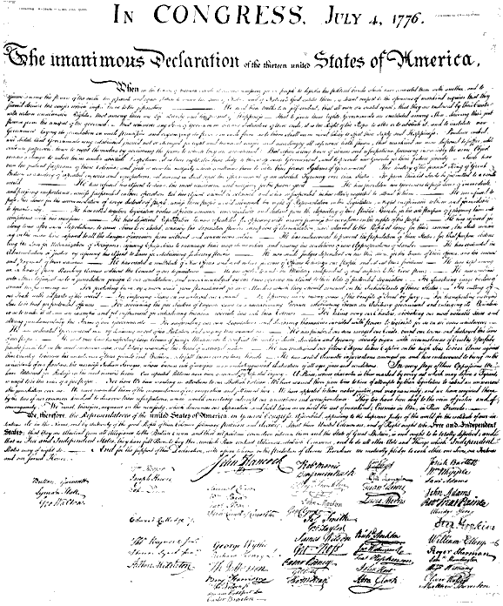
Declaration of Independence
Written by Thomas Jefferson.
Approved July 4, 1776
Lists grievances (complaints) against the king about his abuse of power
Like Locke’s social contract it says that government is the created by the people and must serve the people
Makes it clear that the government must follow rules just like the people

Slide 3
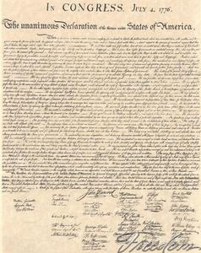
The Declaration of Independence
“We hold these truths to be self-evident that all men are created equal”
“They are endowed by their Creator with certain UNALIENABLE rights”
“Among those rights are “Life, liberty and the pursuit of happiness”
“To secure those rights, governments are INSTITUTED among men…deriving their powers from the consent of the governed”

Slide 4
The Four Stanzas of the Declaration of Independence
Part One: The Preamble, an explanation of purpose. Establishes natural rights and the idea that governments power comes from the people.
Part Two: A list of grievances against King George III (examples on following slide).
Part Three: A resolution that “…these United Colonies are…and of right ought to be Free and Independent States.

Slide 5
A Selection of Grievances
…against King George III
For quartering large bodies of armed troops among us.
For imposing taxes on us without our consent.
He has affected to render the Military independent of and superior to the Civil Power.
For cutting off our trade with all parts of the world.
He has endeavored to bring on the inhabitants of our frontiers the merciless Indian Savages, whose know rule of warfare is an undistinguished destruction of all ages, sexes and conditions.
He has plundered our seas, ravaged our Coasts, burned our towns and destroyed the lives of our people.

Slide 6
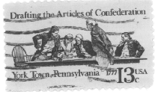
Articles of Confederation
1777
First written constitution for the newly independent states
Granted most of the power to the states
The national government was supposed to provide protection for the people
There was only one branch of government: Congress

Slide 7
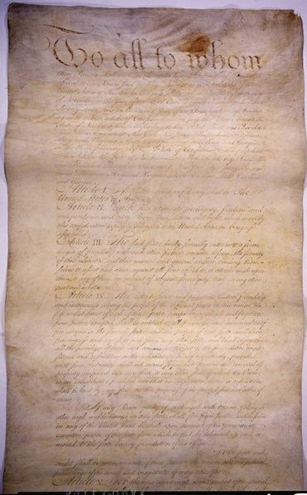
What was the National government’s role under the Articles?
Declare war
Coin Money
Establish Post Offices
Send and recall Ambassador

Slide 8
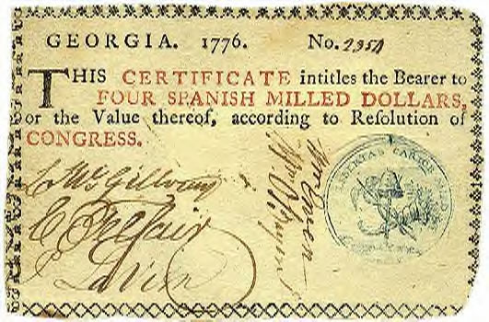
Weaknesses of the Articles
Congress could not collect taxes from the states
Congress could not control the currency in the states
Congress could not regulate trade/commerce (states could place tariffs on each other. States had their own money.)
9 states were needed to make decisions
ALL 13 states had to agree to amendments to the Articles
there was no executive (president) or judicial (court) power
Each state got 1 vote no matter how big or small
Members of Congress only served 1 year terms
Congress couldn’t pay the army
Congress couldn’t enforce it’s laws

Slide 9

Question:
Why did so many Americans tolerate the weak government established by the Articles of Confederation?

Slide 10

Answer:
For most Americans, respect for freedom was so great, and fear of tyranny so intense, that a strong national government was an unacceptable risk!

Slide 11
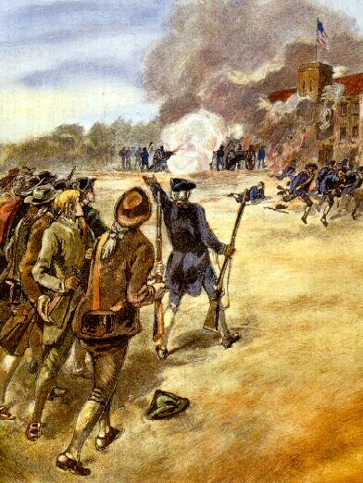
Shays’ Rebellion
Massachusetts, 1786-1787
To pay off debt, legislators passed a heavy direct tax on Massachusetts citizens.
It could only be paid in specie—GOLD OR SILVER—not in paper money.
Farmers in the west, already in debt, could not pay the tax.
Many had their possessions seized by the government for non-payment.

Slide 12
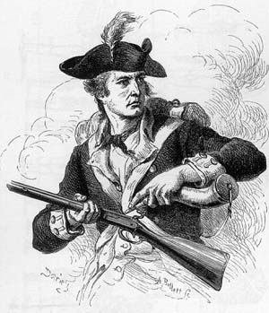
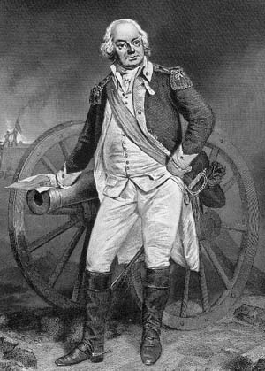
Daniel Shays
Was a Revolutionary War veteran and small farmer.
Could not pay his debts and was facing jail time.
In 1786, he led a rebellion that spread through the area.
Tax collectors were driven off and courts were closed down by the rebels.

Slide 13
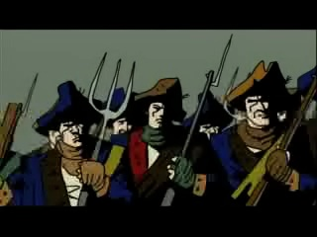
Helpless…
The government, with no army, couldn’t stop him.
A group of wealthy Bostonians finally raised a private army to confront Shays.
They were finally defeated in February, 1787.
Shays and a few others were sentenced to death.

Slide 14
Differing Views of Shays’ Rebellion
Thomas Jefferson: "A little rebellion now and then is a good thing. It is a medicine necessary for the sound health of government. God forbid that we should ever be twenty years without such a rebellion.”
  Translation: The rebellion was NO BIG DEAL.
James Madison: “Liberty may be endangered by the abuses of liberty as well as by the abuses of power”.
  Translation: Our government is TOO WEAK; we must DO SOMETHING.

Slide 15
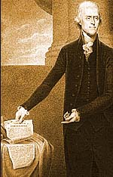
Effects of the Rebellion
Demonstrated Americans’ commitment to defy authority when it acted against the wishes of the people.
Also demonstrated that something had to be done to strengthen the national government.
Leads to another convention, this time in Philadelphia.

Slide 16
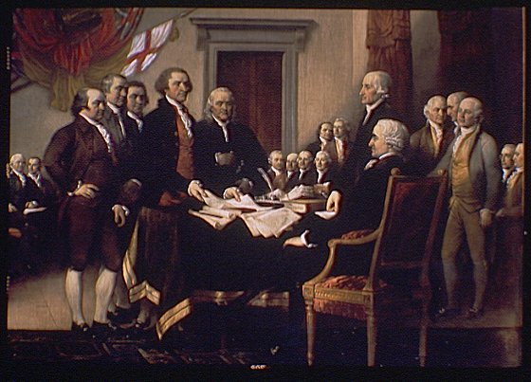
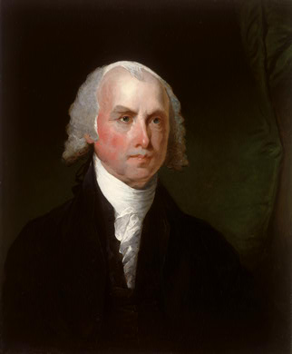
Constitutional Convention
Delegates from each state were asked to come to discuss the problems with the Articles (Rhode Island did not attend)
Delegates were young, well educated, wealthier
George Washington chosen to lead
Each state got one vote
A majority vote was needed to pass measures
7 votes were needed for a quorum (to continue meeting and working)
The meetings were held in secret - no official records were kept
Madison kept most accurate diary –
known as Father of Constitution

Slide 17
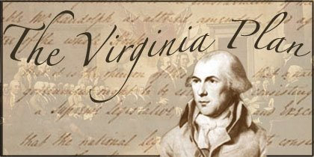
Virginia Plan
(The Large State Plan)
Proposed by Edmund Randolf
3 branches of government
Bicameral Legislature (2 houses)
  Both houses based on population
  Lower House – elected by people
  Upper House – chosen by lower House
Executive (president) chosen by legislature
Judicial (courts) chosen by legislature
National legislature would have veto power over the states

Slide 18
New Jersey Plan
(The Small State Plan)
Proposed by William Patterson
3 branches of government
Unicameral Legislature (one house)
  Equal representation from every state
Multiple executives (presidents) chosen by legislature
Judicial (court) appointed by Executive and approved by legislature
  Appointed for life
Each state gets one vote

Slide 19
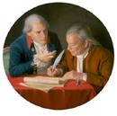
Connecticut Compromise
Proposed by James Madison
3 branches of government
Bicameral Legislature (2 houses)
  Lower House – elected by people
    based on population
    3/5 compromise
  Upper House – chosen by lower House – 2 per state
Executive (president) chosen by Electoral College
Judicial (court) appointed by Executive and approved by legislature
  Appointed for life
Had a national supremacy clause

Slide 20
Three-Fifths Compromise
One difficult question remained…When calculating population, should slaves be included?
  If slaves were counted, the south would be more powerful.
  If slaves were omitted, the south would be weak.
In this compromise, every five slaves would be counted as three people.

Slide 21
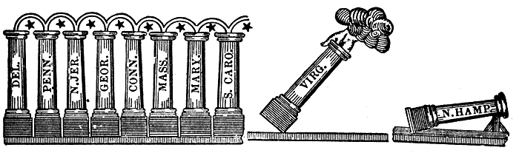
Ratifying the Constitution
Nine of the thirteen states needed to ratify (approve) the Constitution.
Conventions were set up in each state, bypassing the state legislature.
This process was, technically, “treason”.

Slide 22
Opposing Views:
Federalists
Anti-Federalists
Wanted a strong national government.
Led by George Washington, James Madison and Alexander Hamilton.
Produced “The Federalist Papers”, which explained how the government would work.
Argued individual rights and state’s rights weren’t protected
Led by Patrick Henry and Thomas Jefferson.
Feared the President would become King.
Thought the government would come under control of one particular group (a faction).

Slide 23
Compromise:
Bill of Rights
Federalism
Federalists promise to add protections for individuals by amendment
State and national governments, each with their own powers
National government Supreme

Slide 24
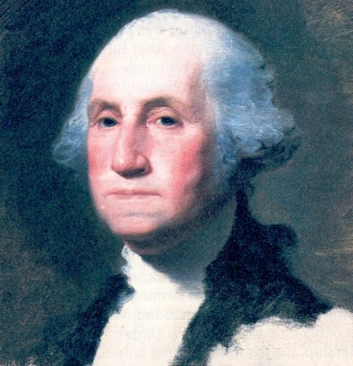
Ratification
Needed 9 of 13 states
  Delaware
  Connecticut
  New Jersey
  Georgia
  Pennsylvania
  Massachusetts
  Maryland
  South Carolina
  New Hampshire was the ninth and final needed vote
  Rhode Island became the last.
New York chosen as first capital
George Washington chosen as first president
New government started in April 1789
Bill of Rights presented in June, 1789

Slide 25
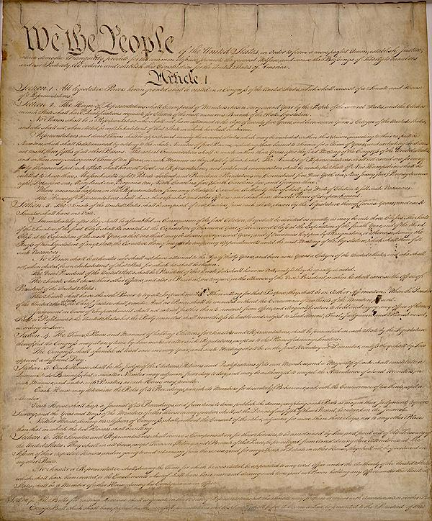
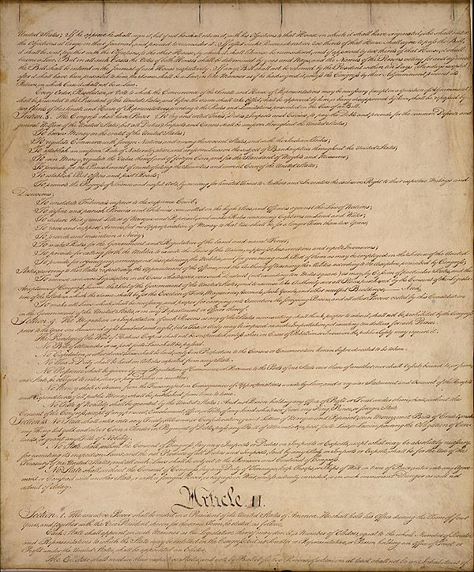
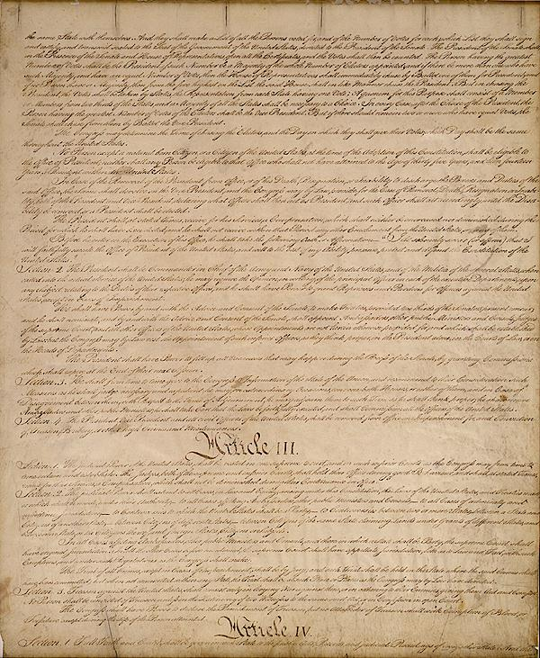
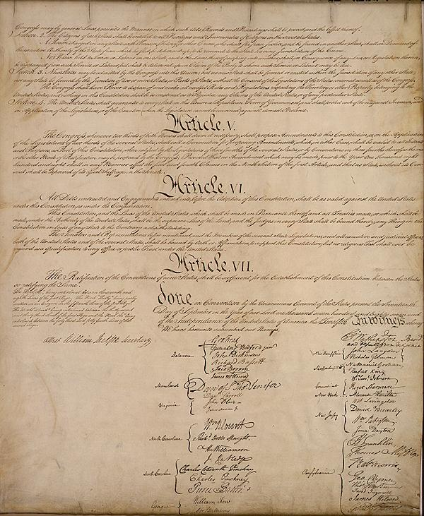
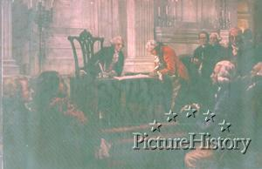

Slide 26
Georgia at the Convention
Georgians played two important roles during the Constitutional Convention. The first role was their unrelenting support of slavery. Led to the Three-Fifths Compromise.
The second important contribution was from Abraham Baldwin. He is given credit for changing his vote to side with the “small states” in the Congressional representation debate. This decision evened the numbers for and against the Virginia Plan and allowed for the Great Compromise to be determined. Baldwin claimed that this act was one of his greatest accomplishments.

Slide 27
Abraham Baldwin
Abraham Baldwin was one of four Georgians sent to the Constitutional Convention and one of two who signed the document.
Starting in 1789, Baldwin served 5 terms as a U.S. Congressman and later two terms as a U.S. Senator.
He died in office in 1807.
However, Baldwin is probably most famous for his role in the creation of the University of Georgia and his position as the University’s first president (1786-1801). Due to Baldwin’s influence, it has been said that many of the early building on the campus of the University of Georgia were modeled after buildings found at his alma mater Yale.

Slide 28
William Few Jr.
William Few fought in the American Revolution, served as a state legislator, and was appointed as one of Georgia’s representatives to the Constitutional Convention.
When he lived in Georgia, he served as one of the state’s senators, a state representative, and as a judge.
In 1799, due to the urging of his wife who was a native New Yorker, he moved to New York City where he became a member of the New York legislature for four years as well as a bank president.
Few lived the remainder of his life in New York. Interestingly, in 1976, to honor the nation’s bicentennial, Few’s remains were moved back to Georgia.

Slide 29
Constitution Trivia
For 146 years it was never seen in public
In 1894 it was placed b/t two pieces of glass in the State Dept. basement
In 1921 it was moved to the Library of Congress (not displayed until 1924)
19 days after the attack on Pearl Harbor it went to Fort Knox until Oct. 1, 1944
Moved to National Archives in 1952
Kept in bombproof, shockproof, fireproof vault with steel and reinforced concrete; kept on spring system to raise and lower each day
Published by Dunlap and Claypool (1320 copies for $420)
Only 500 final copies made, only about 6 left in existence

