Slide 1
Unit 3 Revolutionary Period
Part 1

Slide 2
Standard S8H3
SS8H3 Analyze the role of Georgia in the American Revolutionary Era.
a. Explain the causes of the American Revolution as they impacted Georgia; include the French and Indian War, Proclamation of 1763, and the Stamp Act.
b. Interpret the three parts of the Declaration of Independence (preamble, grievances, and declaration) and identify the three Georgia signers of the document.
c. Analyze the significance of the Loyalists and Patriots as a part of Georgia’s role in the Revolutionary War; include the Battle of Kettle Creek and Siege of Savannah.
d. Analyze the weaknesses of the Articles of Confederation and explain how those weaknesses led to the writing of a new federal Constitution.

Slide 3
French and Indian War
Rivals for an empire:
In 1750’s France was Britain's biggest rival in the struggle to build a world empire. Major area of contention was the Ohio river valley.
Colonists favored Britain because they still thought of themselves as British.
Colonies wanted to expand westward due to crowding Atlantic seaboard.

Slide 4
French in North America
French settled Quebec in 1608.(Jamestown 1607)
In Quebec French priests and traders spread into the heart of the continent.
1682 Claimed the entire Mississippi Valley. Named it Louisiana after King Louis XIV. (14)
Very few French in “New France” 70,000 to Britain's 1,000,000.

Slide 5
French-Native Relations
French differed from British in relations with Natives Americans.
French colonies typically included Fur Traders and Catholic Priests who wanted to convert Natives. (british wanted to build towns, raise families)
Developed friendly relationships with natives. Let the native americans do the hunting and traded with them for fur. (PROFIT!)
French helped friendly tribes defeat other tribes. 1609 helped Algonquin defeat Mohawk Iroquois.

Slide 6
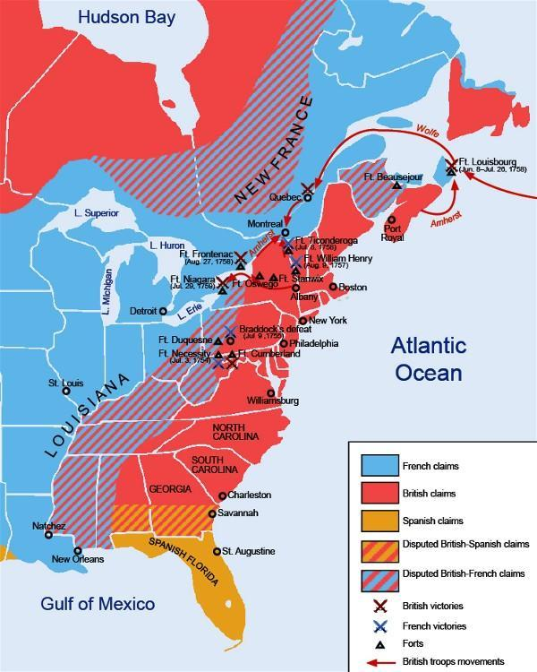
Britain Defeats an Old Enemy
France and Great Britain both are trying to gain resources in North America.
Disagreement begins at Fort Duquesne.
Located where the Allegheny and Monongahela rivers join to form the Ohio. (modern day Pittsburg)

Slide 7
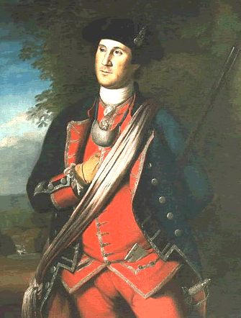
Washington Defeated
British had previously granted 200,000 acres of land to the Ohio country to a group of wealthy planters.
Virginia governor sent militia. (small group of citizens with weapons)
Group was lead by George Washington(22 years old).
Washington and his men attacked the French but were defeated. Washington surrenders and the French and Indian war begins

Slide 8
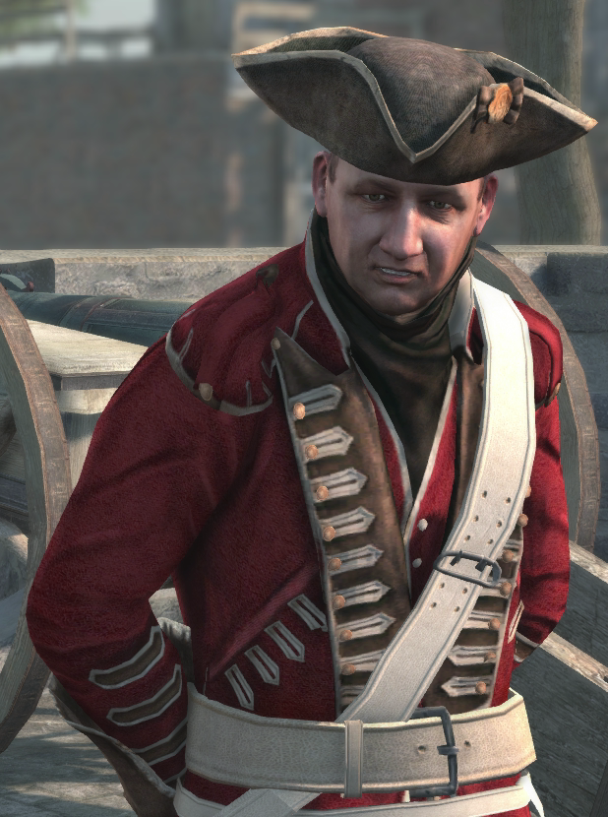
Washington Tries Again
A year after his defeat Washington heads to battle with British General Edward Braddock.
Braddock launched attack on Fort Duquesne with nearly 1500 soldiers.
Horribly defeated. French and Indian allies fought from behind trees. British stood in straight lines. British Flee battle.

Slide 9
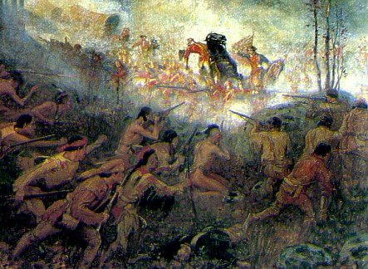
British Weak?
Washington showed incredible courage in battle.
British were supposed to be invincible.
However British lost battle after battle.

Slide 10
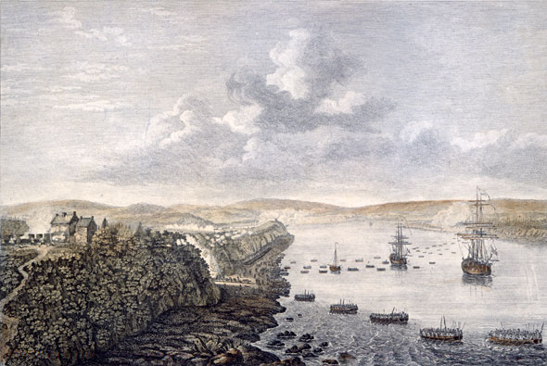
British Win!
September 1759 war took a dramatic turn.
General James Wolfe scaled the high cliffs that protected Quebec
Caught the French off guard and won a short but deadly battle.
War officially ended in 1763 with the Treaty of Paris.

Slide 11
War Ends
Britain took all of North America east of the Mississippi River(including Florida).
Spain gained the French lands west of the Mississippi. French only kept a few small islands .
Indians real losers. They found the British harder to bargain with.

Slide 12
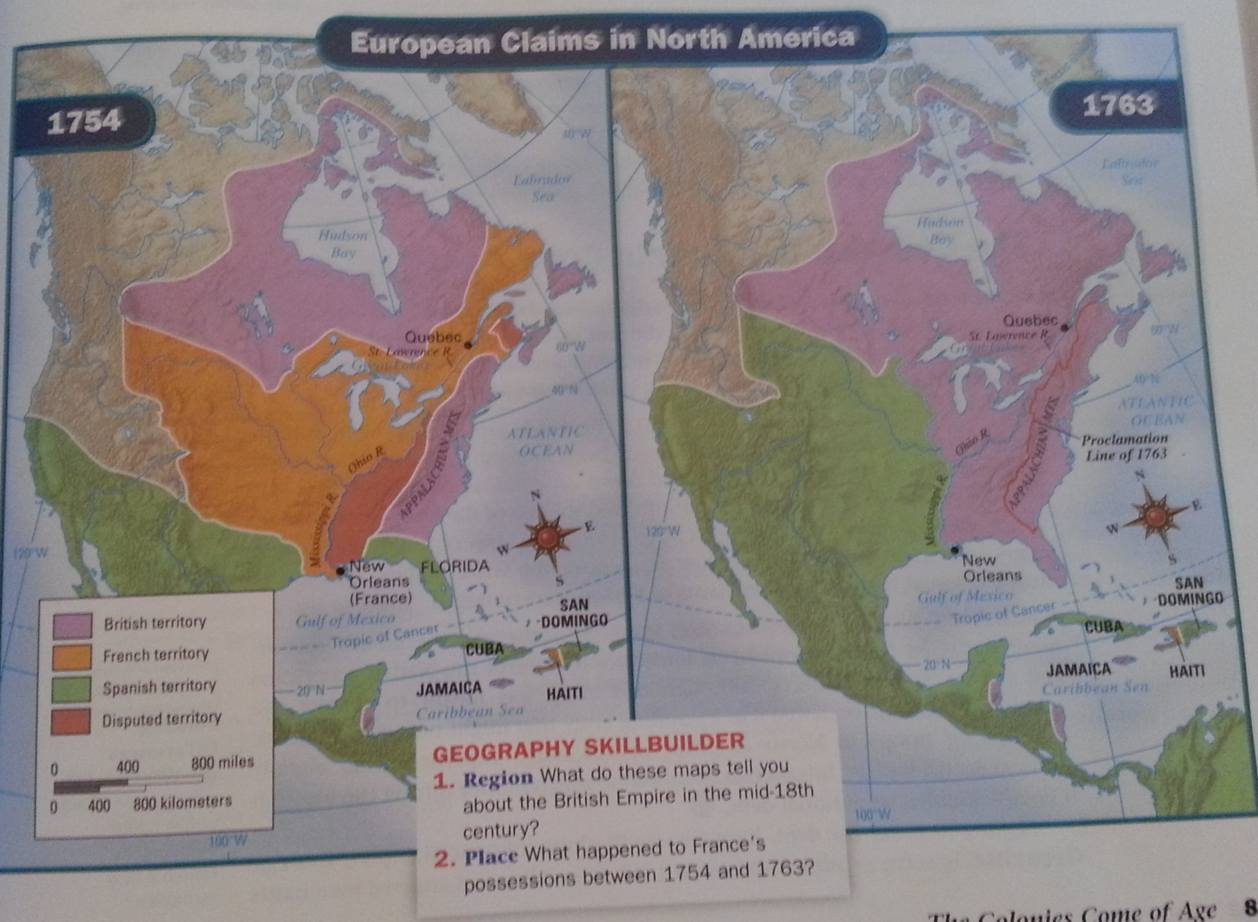

Slide 13
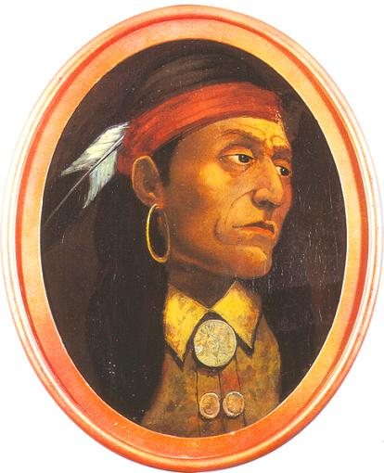
Pontiac

Slide 14
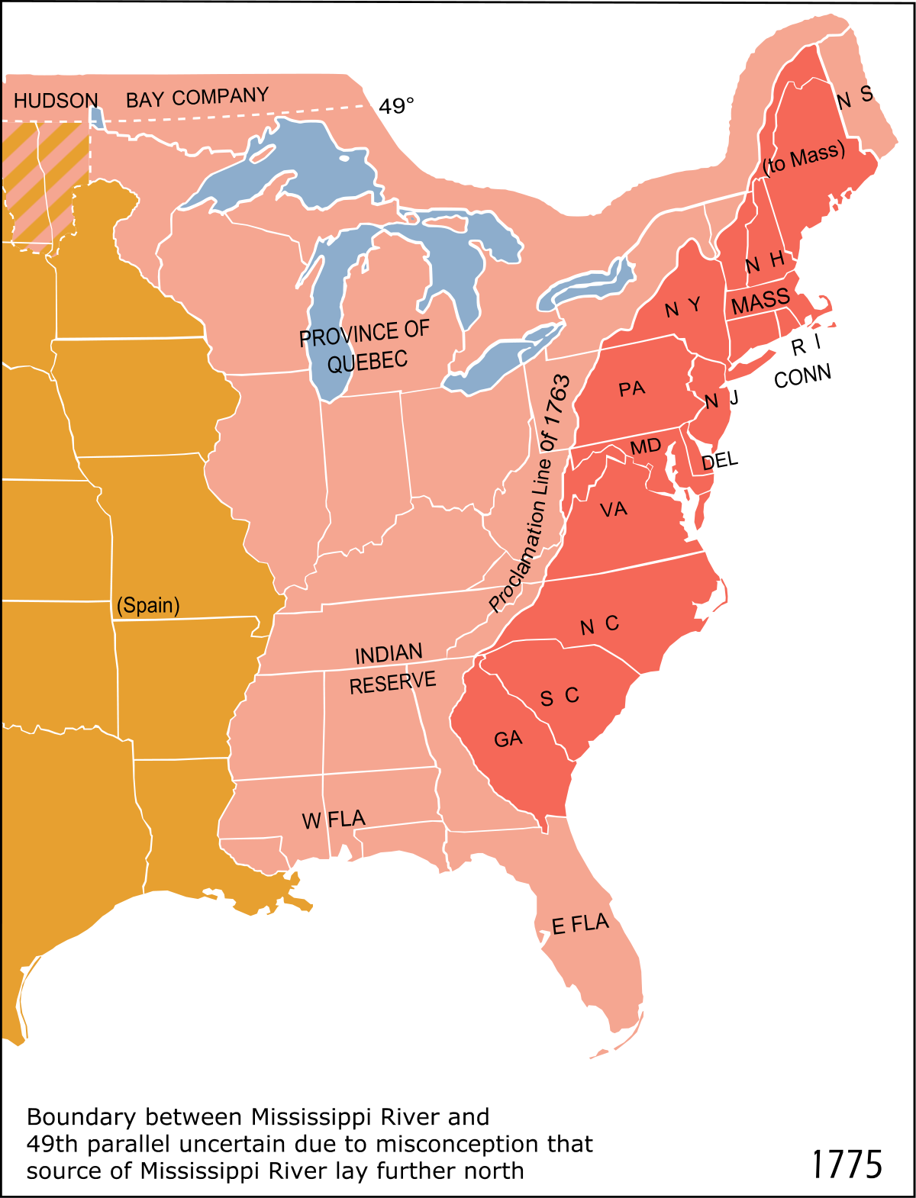
Proclamation of 1763
To avoid further conflicts with Native Americans, British Government issued the Proclamation of 1763, which banned all settlement west of the Appalachians.
Established the Proclamation Line.
However British could not effectively enforce this law.

Slide 15
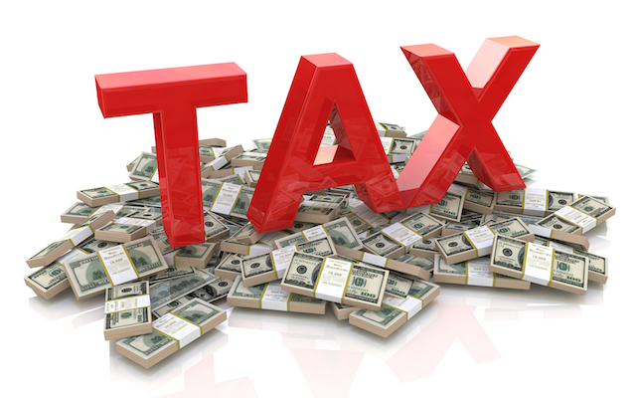
Colonies and Britain Grow Apart
Proclamation of 1763 sought to halt expansion. Colonists were convinced the British Government didn’t care about their needs.
War caused financial crisis and forced the British to pass laws that made the colonists even less pleased with the British.

Slide 16
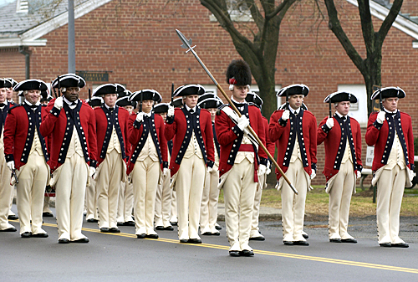
Problems Resulting From War
After war British stationed 10,000 troops in colonies to control Native Americans.
Colonists saw this as an army that could turn against them.
Maintaining troops is expensive. During war British had doubled their national debt.
British needed to generate revenue in order to pay back debts.

Slide 17
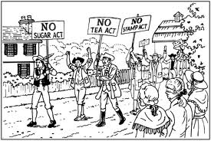
Sugar Act
King George III appointed George Grenville to serve as prime minister in 1763.
Grenvile suspected that the colonists were smuggling goods into the country.
1764 he prompted Parliament to pass the Sugar Act.
Halved the duty on foreign-made molasses.(from 6 pence to 3)
Strengthened Enforcement of smuggling laws. Military courts rather than colonial courts.

Slide 18
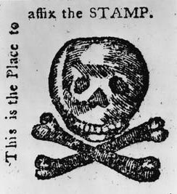
The Stamp Act
March 1765 Parliament passed the Stamp Act.
Required colonists to purchase special stamped paper for every legal document, license, newspaper, pamphlet, and almanac.
Imposed “stamp duties” on playing cards and dice.
Colonists who disobeyed the law were to be tried in military courts not colonial courts.

Slide 19
Stamp Act Protests
Colonists instantly banded together to resist the stamp act.
Groups such as the Sons of Liberty were formed by shopkeepers, artisans, and laborers.
One of the founders of the Sons of Liberty was Samuel Adams.
Sons of liberty harassed customs workers, stamp agents, and royal governors. Stamp collectors resigned.
The Stamp Act was to become effective on November 1st but the protests prevented stamps from being sold.
Georgia was the only colony that officially used the stamps, earning anger among her other colonies.

Slide 20
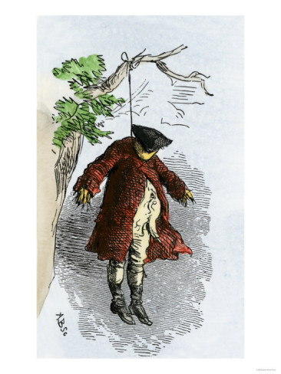
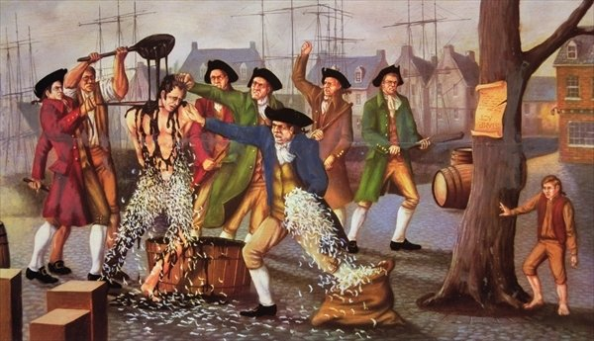

Slide 21
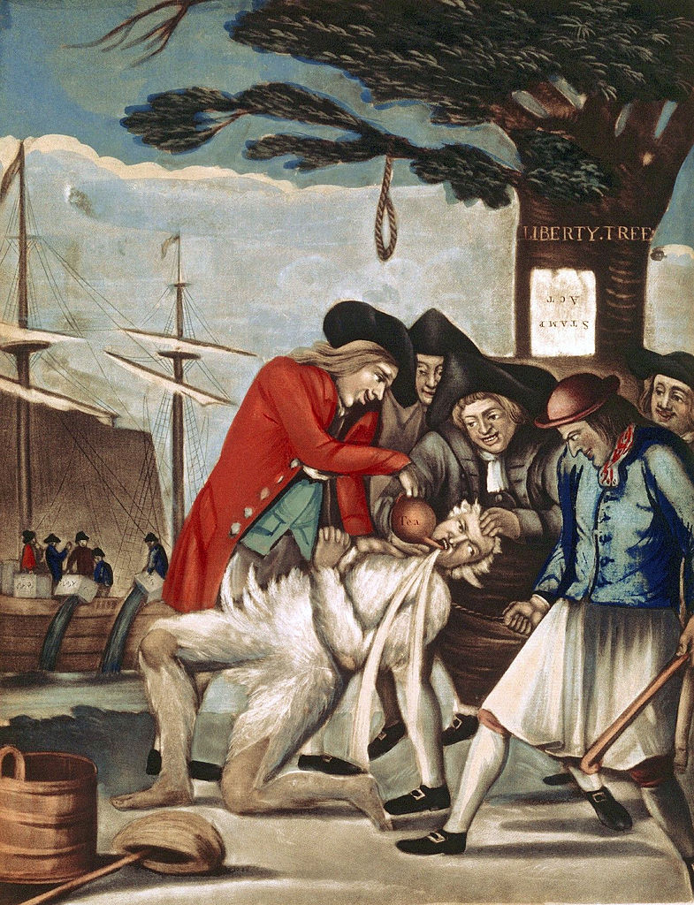

Slide 22
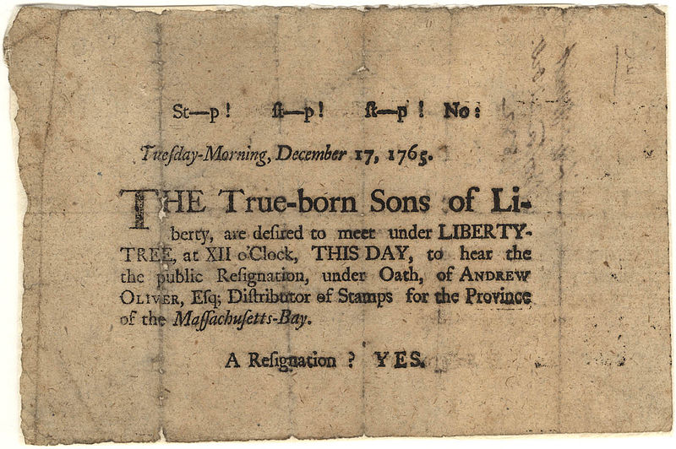
Broadside

Slide 23
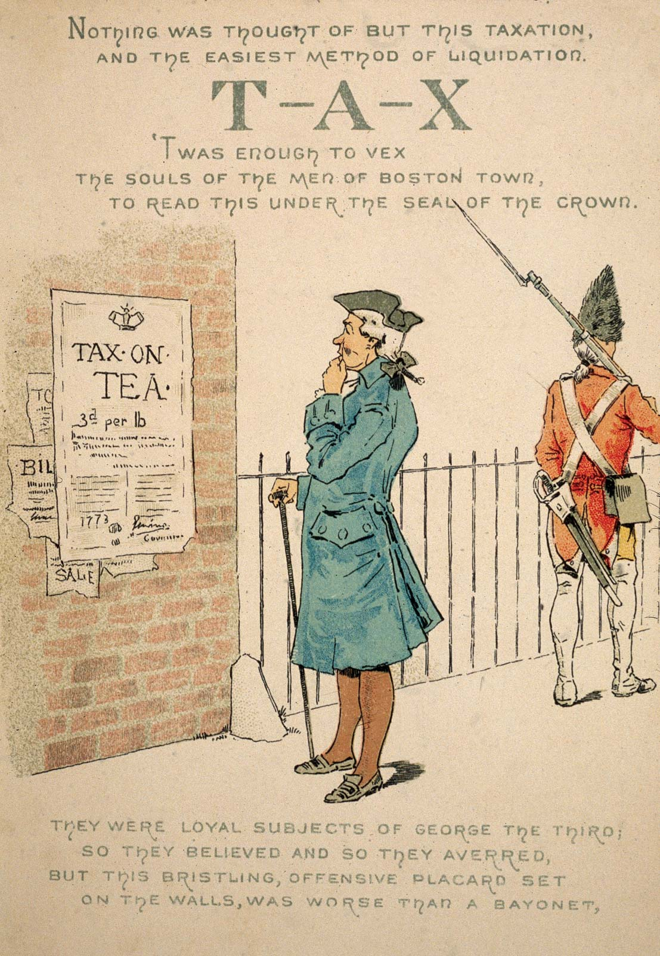
The Townshend Acts
Within a year after the repeal of the Stamp Act, Parliament passes the Townshend Acts.
Townshend Acts- tax on imported glass, lead, and paper from Britain.
Also included a 3 cent tax on tea.
Tea Act

Slide 24
Townshend Protests
“No taxation without representation”.
Samuel Adams called for boycott of British goods.
Even the women joined in on the protests.
Mercy Otis Warren, “Lay female ornaments aside” “forgo feathers, furs, rich satins and capes”.
Held Spinning and Weaving Bees.
Made tea from birch bark and sage.

Slide 25
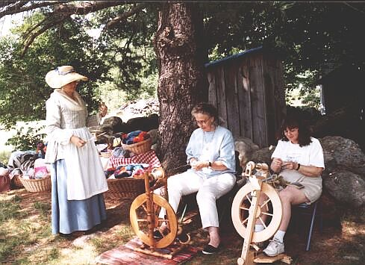

Slide 26
Boston Massacre
Presence of soldiers lead to a feeling of hostility.
British soldiers were poorly paid and would often look for other jobs. This forced competition for work between colonists and soldiers.
A fight broke out between a colonist and a soldier over a job.
This fight lead to a protest at a Customs House where the colonists taunted the guards.
The protest turned violent and 5 people were killed.
Samuel Adams and others labeled the event the Boston Massacre.(attack on defenseless)

Slide 27
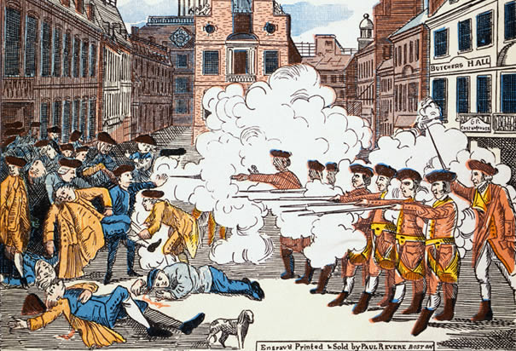

Slide 28
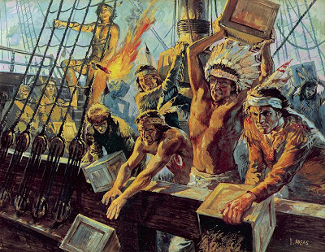
Boston Tea Party
December 16, 1773.
Group of Boston rebels disguised themselves as Native Americans and dumped about 18,000 pounds of tea into the Boston Harbor.

Slide 29
Part III: Revolution Incoming

Slide 30
The Intolerable Acts
King George III was infuriated by the Boston Tea Party.
1774 Parliament responded by passing a series of measures that the colonists called the Intolerable Acts.
Shut Down Boston Harbor
Quartering Act
Boston placed under rule of General Thomas Gage. Martial law enacted!

Slide 31
First Continental Congress
As a result of intolerable acts the first Continental Congress met in September 1774.(Philadelphia)
Drew up declaration of colonial rights.
Defended the right to run their own affairs.
Stated that if British used force against the colonies, the colonies should fight back.

Slide 32
Fighting Erupts at Lexington and Concord
After First Continental Congress many New England towns started military preparations.
Minutemen or civilian soldiers began to quietly stockpile firearms and gunpowder.
General Gage learns about these activities and prepared to strike back against the colonists.

Slide 33
To Concord, By The Lexington Road
Spring of 1775 was a cold one in New England. Food was scarce. General Gage was forced to put his army on strict rations and British morale was low.
Gage became concerned about reports brought back to him about weapons hidden outside Boston.
Gage sent soldiers to investigate and they returned with maps detailing where the weapons were. They also heard that John Hancock and Samuel Adams were staying in Lexington.

Slide 34
“The Regulars are Coming!”
Gage drew up orders for his men to march along Lexington Road to Concord to seize and destroy all munitions.
As general Gage began to ready his troops the minutemen were watching.
Paul Revere a member of the Sons of Liberty was tasked with warning Adams and Hancock to evacuate Lexington.

Slide 35
“The Regulars are Coming!”(Continued)
On the Night of April 18, 1775 Paul Revere, William Dawes, and Samuel Prescott rode out to spread word that 700 British Regulars were headed for Concord
Countryside rang with church bells, gunshots and other prearranged signals to warn the citizens about the British.
Revere warned Adams and Hancock to flee but he was captured later by the British. However he was let go once gunshots were heard.(so general could travel faster)

Slide 36
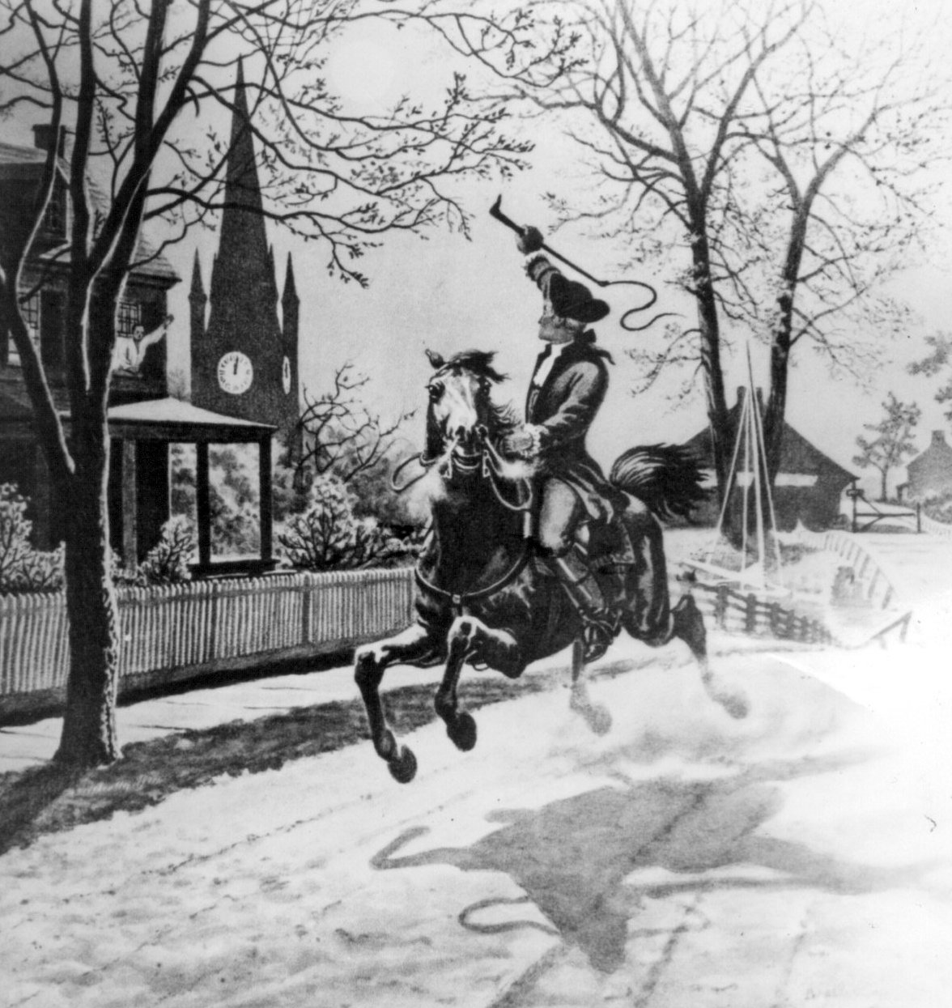

Slide 38
Fighting Erupts at Lexington
By April 19, 1775 troops had reached Lexington.
At their arrival the troops saw 70 minutemen ready to fire. They asked them to surrender and they did but didn’t lay down their guns.
Someone fired and a battle started.
8 minutemen were killed and only 1 British soldier was killed.
Battle lasted about 15 minutes.

Slide 39
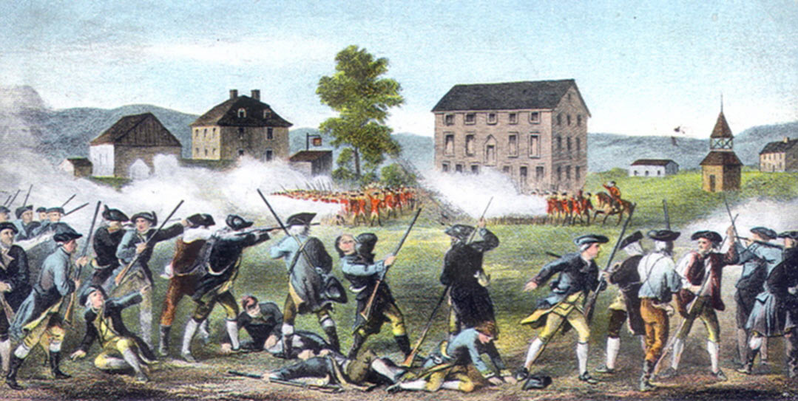

Slide 40
Battle of Concord
After Lexington the British marched onto Concord. Upon arrival they found only an empty arsenal.
The British intended to march back to Boston but about 3-4 thousand minutemen had assembled and began to attack the British.(shot from behind stone walls and trees)
British were slaughtered.

Slide 41
