Slide 1
Unit 2: Part 2
The Creation of Georgia

Slide 2
Standard of Excellence
SS8H2 Analyze the colonial period of Georgia’s history.
Explain the importance of the Charter of 1732, including the reasons for settlement (philanthropy, economics, and defense).
Analyze the relationship between James Oglethorpe, Tomochichi, and Mary Musgrove in establishing the city of Savannah at Yamacraw Bluff.
Evaluate the role of diverse groups (Jews, Salzburgers, Highland Scots, and Malcontents) in settling Georgia during the Trustee Period.
Explain the transition of Georgia into a royal colony with regard to land ownership, slavery, alcohol, and government. e. Give examples of the kinds of goods and services produced and traded in colonial Georgia.

Slide 3
Glossary
Royal period (colony) - the royal period in Georgia beginning in 1752 after the trustees gave authority of the colony to the king. The royal period lasted until the Treaty of Paris ended the American Revolution in 1783.
Savannah - The first capital of Georgia; founded in 1733 by James Oglethorpe.
Trustee(s) - An individual or organization that holds or manages and invests assets for the benefit of another. A group of 21 men who established the colony of Georgia. Of the group, only one, James Oglethorpe, came to the colony.
Trustee period (1732-1751) - the time period when Georgia was governed by the trustees. The trustees created many regulations during the time period, including a ban on slavery, liquor and liquor dealers, lawyers, and Catholics.

Slide 4
Charter of 1732
Georgia’s Charter of 1732 outlined in detail the reasons for Georgia’s settlement.
Georgia was founded for three primary reasons:
Philanthropy
Economics
Defense
Of the three, the only true success the colony had under the Trustees was Georgia’s defense of South Carolina against Spanish invasion.

Slide 5
Philanthropy
Oglethorpe was concerned about the treatment of prison conditions for indebted people in England. (Parliament, Robert Castell)
Wanted to create a colony for a group he called the “worthy poor”. (never happened)
While most of Georgia’s first settlers were not wealthy, many were skilled craftsmen who were looking for a “new start”.
Incentives, including 50 acres of land (500 acres if the colonists paid their own passage), one year’s supply of food, and free seed and agricultural supplies for a year, were too enticing for many people to disregard and was more than they could expect to have if they remained in England.
This philanthropic gesture caused many to try their luck in the new colony.

Slide 6
Economics
Mercantilism was a guiding factor in the establishment of the colony of Georgia.
The Trustees hoped that the colonists of Georgia would be able to produce four agricultural products that could not be grown successfully in England.
Rice, indigo, wine, and, most importantly, silk were the crops that were desired in England.
Silk was so important to the trustees that all colonists were required to set aside land on which to grow mulberry trees. The mulberry leaves were the food of choice for silkworms.

Slide 7
Economics
None of the crops reached the level of success desired by the Trustees.
During the colonial period, Georgia’s wine industry never produced sufficient quantities for successful export and the silk industry did not return the profits that were desired.
Rice, indigo, and tobacco were more successful during the Royal period and early statehood period.
A helpful mnemonic for these crops is W.R.I.S.T.

Slide 8
Defense
The most important reason for Georgia’s founding was defense, primarily against the Spanish in Florida. In the 1730’s, South Carolina was a profitable British colony that was threatened by Spanish military outposts in Florida.
The Georgia colony’s role was to serve as a military “buffer” between the two. Evidence of the buffer zone includes the forts that Oglethorpe constructed between Spanish Florida and Georgia and his bringing the highly-skilled Highland Scots to reoccupy the abandoned Fort King George (near modern-day Darien) in 1736.

Slide 9
The War of Jenkins’ Ear
The War of Jenkins’ Ear was important to the survival of the colony of Georgia and helped Georgia serve its function as a buffer for South Carolina from the Spanish in Florida.
The war was named after a British captain, Robert Jenkins, whose ear was cut off by the Spanish after he attempted to raid one of their ships.
Jenkins, who survived the attack, brought his ear to the English Parliament which in turn caused the English public to demand retribution against the Spanish.

Slide 10
Jenkins’ Ear Continued
Once war was declared, James Oglethorpe made a failed attempt to capture St. Augustine. After the British retreated, Spain decided to attack and destroy the young Georgia colony.
The Spanish attacked St. Simon’s Island but were soundly defeated by the colonists and their Indian allies during the Battle of Bloody Marsh.
After this battle, the Spanish never overtly threatened the colony again. In 1748 both sides agreed that the border between English Georgia and Spanish Florida would be the St. Johns River.

Slide 11
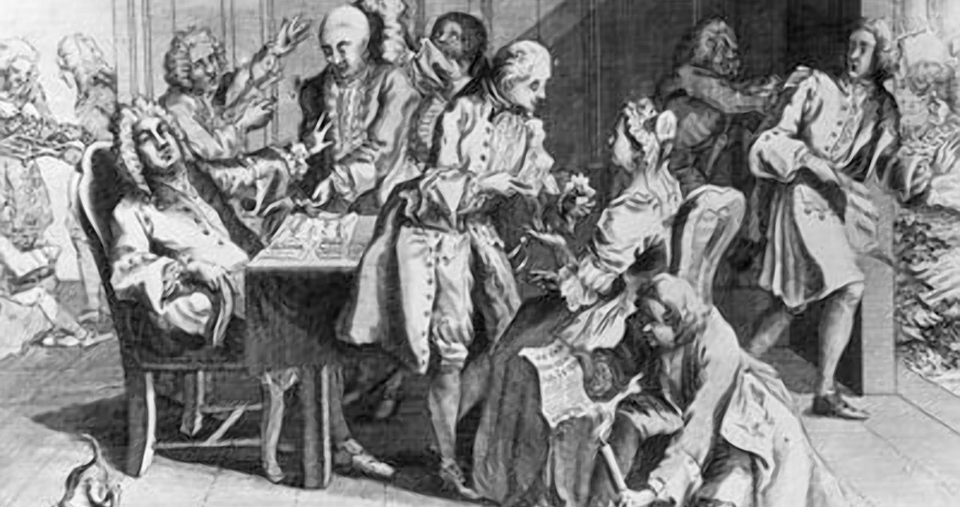

Slide 12
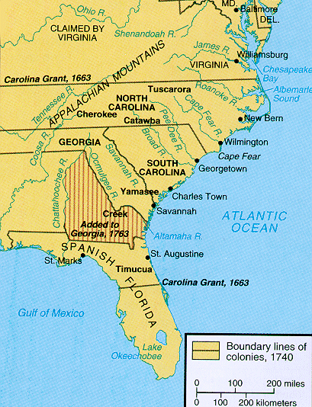

Slide 13
Charter of 1732
The Charter of 1732 created strict guidelines for Georgia colonists.
To ensure an unbiased role in the colony, Trustees were not paid, could not own land, or hold office in the colony.
Because the colony was to support the “worthy poor,” the Trustees initially forbade rum (hard alcohol) as they feared hard liquor would cause the colonists to become idle and avoid hard work.
Slavery was also forbidden as the Trustees hoped to avoid what had happened in South Carolina: the creation of large plantations versus the small farmers who struggled (the wealthy v. the poor).

Slide 14
Charter of 1732 (continued)
The Trustees also barred liquor dealers and Catholics from the colony. Some historians indicate that lawyers may have been banned as well.
Defending the colony against Spanish, French or American Indian attack was a requirement of the colonists, a major provision of the Charter of 1732.
The production of silk forced the colonists to grow mulberry trees.
Colonists could not sell their land and their land must be passed down to male heirs, and they had to obey all Trustee rules.

Slide 15
Charter of 1732 (continued)
The original Charter also included a prohibition of Jews settling in the colony. However, when the colonists were besieged with medical concerns, a group of Portuguese Jews arrived with a doctor. Oglethorpe, violating Trustee rules, allowed the Jews to settle in Savannah and Dr. Samuel Nunes was credited with “saving the colony.”
The provisions detailed in the Charter of 1732 eventually caused discontent among the colonists. Believing that the provisions were causing few opportunities for economic success, some colonists petitioned for changes in the charter.

Slide 16
Part 3: Establishing a colony in Savannah
Key Players
Oglethorpe-Trustee
Mary Musgrove (Interpreter)- Father was a British citizen and mother was a Creek Indian.
Tomochichi- Chief of the Yamacraw. Friend of Oglethorpe who gives land for Savannah.

Slide 17
James Edward Oglethorpe (1696-1785)
Oglethorpe lobbied to create a new colony and eventually he, along with 20 other Trustees, was granted a charter to establish Georgia.
He was the only trustee to travel to Georgia.
Oglethorpe took on the roles of both military and de facto civilian leader of the colony, and in many cases acted against the policies of the trustees.
He created the towns of Savannah and Fredericka (on St. Simons Island), and fought the Spanish on three separate occasions.
Oglethorpe left Georgia in 1743, never to return.

Slide 18
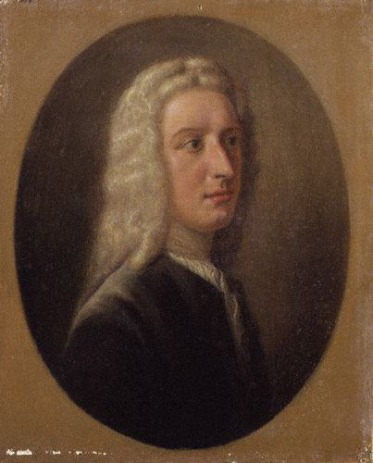

Slide 19
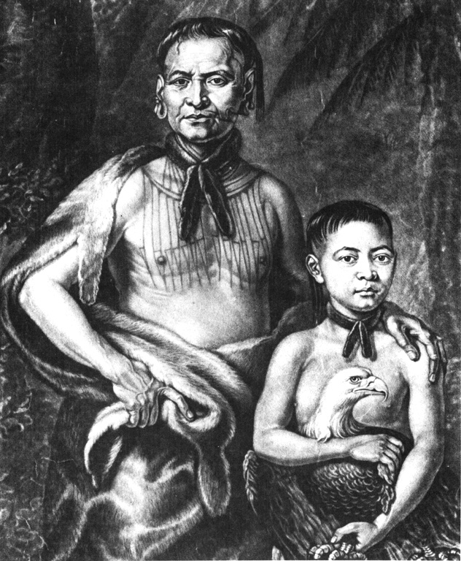
Tomochichi
Leader of the Yamacraw Indians.
Tribe was created out of a disagreement between the Creek and Tamasee Indians over which European power to side with (British or Spanish).
Tomochichi sided with British so when Oglethorpe arrived he allowed them to create the city of Savannah on Yamacraw Bluff.

Slide 20
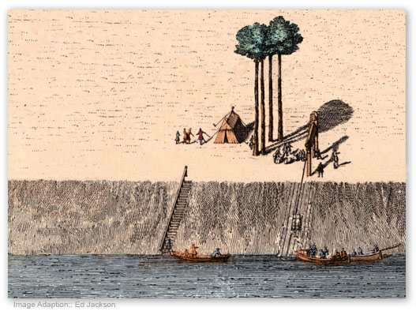
Tomochichi and the Founding of Savannah
Leader of the Yamacraw Indians.
Tribe was created out of a disagreement between the Creek and Tamasee Indians over which European power to side with (British or Spanish).
Tomochichi sided with British so when Oglethorpe arrived he allowed them to create the city of Savannah on Yamacraw Bluff.

Slide 21
Tomochichi (continued)
Oglethorpe and Tomochichi became good friends until Tomochichi’s death in 1739 (in his 90’s!)
Tomochichi helped establish English speaking schools for Native Americans in Georgia.
He was buried in Savannah with full British military honors.

Slide 22
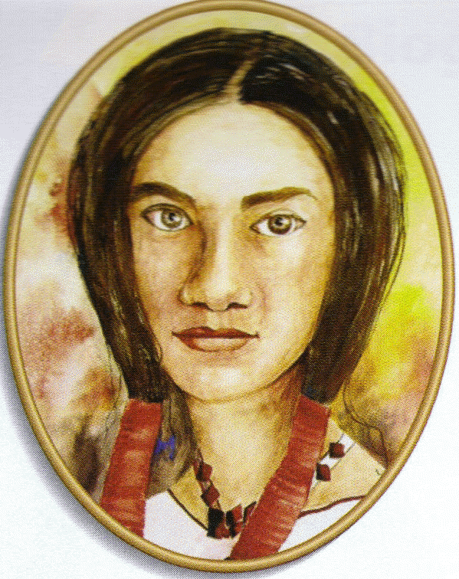
Mary Musgrove
Served as Oglethope’s translator.
She and her husband John ran a successful fur trading business before Oglethorpe was ever in the colonies (1717).
She helped translate between Oglethorpe and Tomochichi
The natives liked her so much they gave her hundreds of acres of land which the British wouldn’t recognize. She led 200 Natives to argue with the British for her land rights. Later was given St. Catherine's Island.

Slide 23
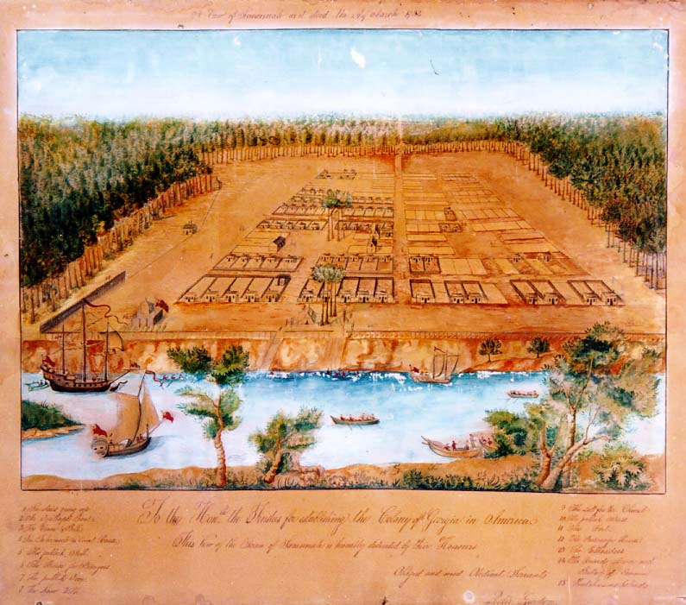
Savannah
Savannah
City was set up in a grid.
Of the original 24 Squares, 22 still exist today.
Last British capital city established in America.

Slide 24
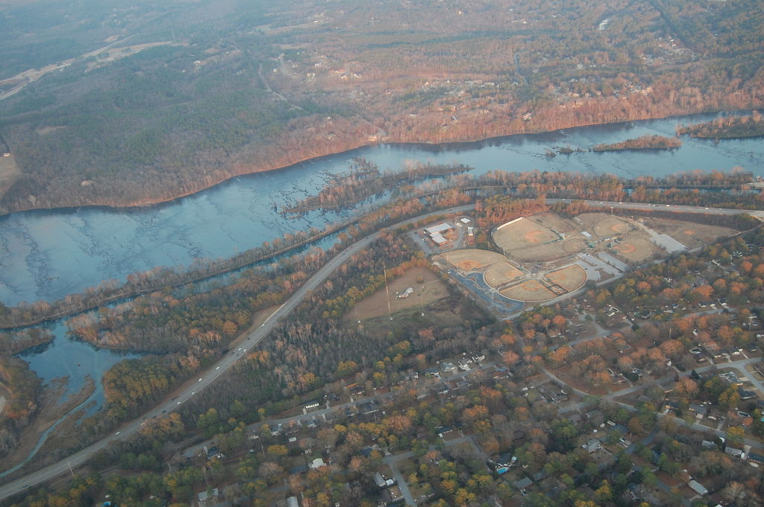
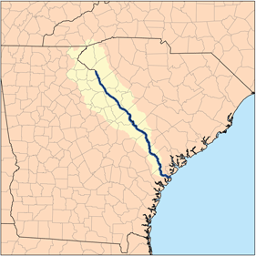
Savannah River
© Brain Wrinkles

Slide 25
Other Groups in Georgia
Jews- Originally banned. 42 arrived 5 months after Oglethorpe and were welcomed because one was a doctor and another was experienced in viticulture (wine making)
Congregation Mickve Israel- Oldest Jewish congregation in south and 3rd oldest in US
Salzburgers- German speaking Protestants who were kicked out of Austria by Catholic monarch. King George II was a German Protestant offered them a home in Georgia.
Settled in town named Ebenezer “Stone of Help” (too swampy, poor water, any deaths)
Moved to “New Ebenezer”- Establish water powered grist mill, Sunday school and orphanage. Also only group to have any success with silk production.
Salzburgers were anti slavery, Oldest Lutheran Congregation in US.

Slide 26
Other Groups in Georgia
Highland Scots- Brought to Georgia by Oglethorpe because of military reputation.
Were given land near the abandoned Ft. King George. They named it Darien.
Fought in the Battle of Bloody Marsh and two attempts at taking St. Augustine from Spanish.
Were Anti-Slavery
Malcontents- These were the individuals angered by the Charter of 1732. Wanted to own more land, own slaves, buy rum. Complained so much that the charter was ended one year early and Georgia became a royal colony.

Slide 27
Royal Colony
The Charter of 1732 ended in 1751.
Rules from Trustee Period became more relaxed as time went on.
Land ownership- Land could be purchased, women could own land, more people came and boarders expanded.
Alcohol- Originally forbidden but was not enforced by 1742. 1749 the Rum Act was repealed.
Slavery- 1749 Slavery became allowed. Agriculture boomed.
No longer ran by Trustees. Instead the King was in charge and he put a Royal Governor in place to run day to day operations.

Slide 28
New Rules
New Rules established by Royal Governor
All males between 16 and 60 had to be in militia
All males had to work on roads at least 12 days a year
White males with land could vote
Georgia’s General Assembly
Upper House- Appointed
Lower House- Elected

