Slide 1
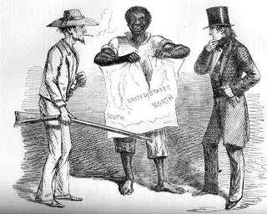
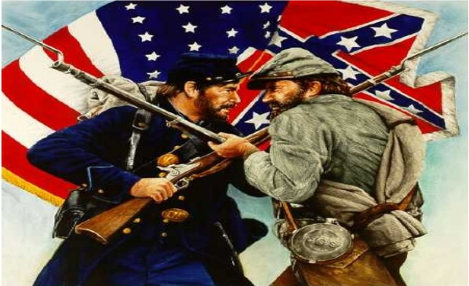
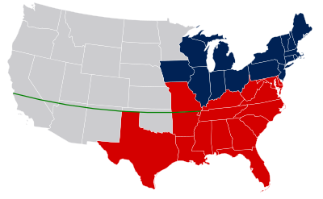
Events Leading up to the Civil War

Slide 2
Let’s Get This Out Of The Way….
The Civil War had one primary cause: SLAVERY.
Some people will claim that the Civil War was about “States Rights”. This is valid but the “right” the Southern States wanted was to own slaves.
Southern States claimed that slaves were property not people. They knew this was wrong. Despite knowing slavery was morally wrong, they were making too much money to stop.
Not all Southerners owned slaves, but many poorer people in the South were tricked into fighting for the rich people to continue owning slaves.
Slavery

Slide 3
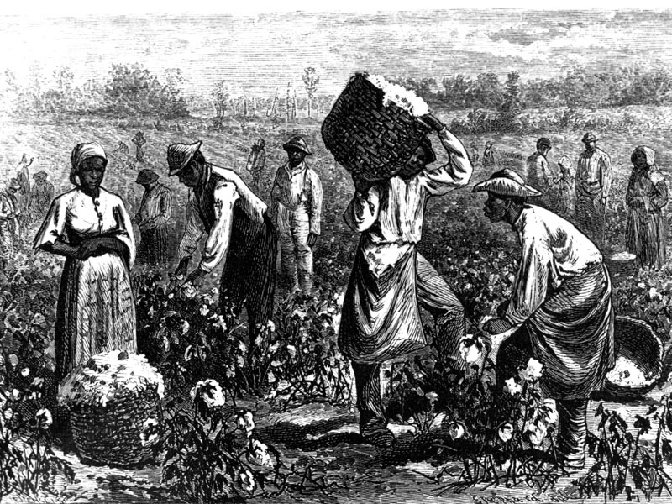
Slavery in Georgia
Due to the rules of the Trustees, slavery was not allowed in Georgia until the early 1750’s.
Once it was legalized, slavery grew quickly due to Georgia’s agriculture-based economy.
However, slavery grew exponentially with the invention of the cotton gin.
The South’s economic dependence on cotton led to a change of attitude about the evils of slavery. While many of the nation’s founding fathers disliked slavery, and hoped that later generations would find a way to end it, their sons and grandsons began to defend slavery as a necessary good and began infringing on the rights of those who spoke out against it in the South.

Slide 4
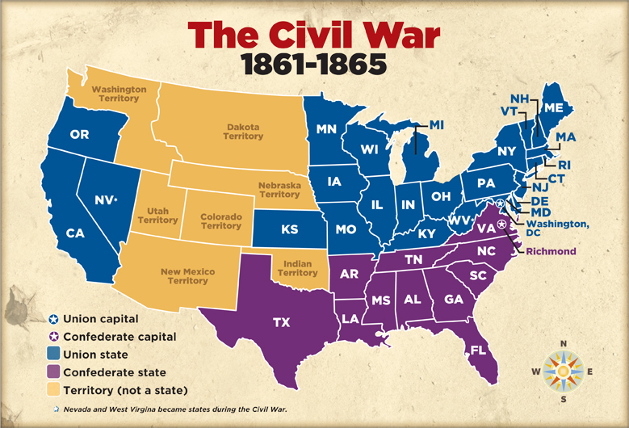
North/South Divide
Sectionalism- loyalty to a region, or town, rather than the whole country. Describes the growing division between slave states and free states.
Slavery was viewed differently in the North.
Their economy wasn’t based on plantation agriculture so slavery wasn’t as prominent.
In the early 1800’s many northerners began to embrace abolition. This is the belief that ending slavery was the right thing to do.

Slide 5
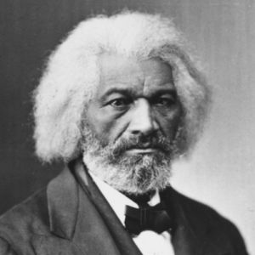
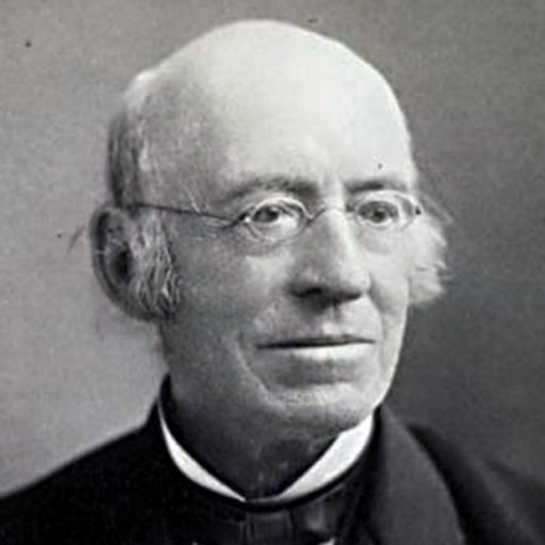
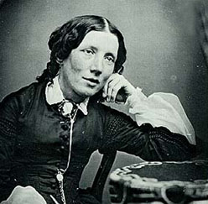
Prominent Abolitionists
Fredrick Douglass- Escaped slave who taught himself to read. Would openly debate proslavery politicians. Ran an abolitionist newspaper called “The North Star”.
Harriet Beecher Stowe- Wrote a book called “Uncle Tom’s Cabin”. Antislavery novel.
William Lloyd Garrison- Wrote an abolitionist newspaper called “The Liberator”.
Harriet Tubman- “Black Moses” leader of the Underground Railroad.

Slide 6
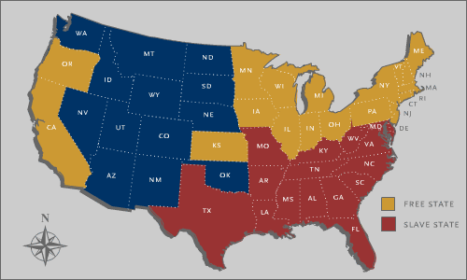
New Territory Divides the US along regional lines.
During the 1800’s the US is going to have a belief called “Manifest Destiny”. The idea that the US owned everything from the “Atlantic to Pacific”.
This belief is going to lead to vast US territorial expansion during this time.
As new states are added there is going to be rising tension between free and slave states about whether these new territories are going to allow slavery.

Slide 7
New States-Balance of Power
The debate over new states being slave or free stems from representation in congress.
Slave states are worried that they will be outnumbered by free states that will vote to end slavery. Free states are worried that being outnumbered by slave states will allow slavery to spread to all states.
The solution to this problem for a while is to always create states in pairs, one slave and one free.

Slide 8
Missouri Compromise
1820
Missouri was going to be added to the Union as a slave state.
In order to maintain the balance of power the North required the creation of Maine as a free state.
Also created a “compromise line” that said any state created below Missouri would be slave, and anything above would be free.

Slide 9
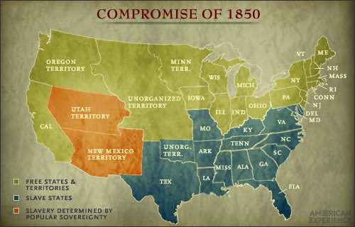
Compromise 1850
Passed in 1850 (shocking I know)
Lead to the creation of California as a free state.
Controversial because this would lead to more free than slave states.
South gets something in return. A fugitive slave act that required escaped slaves be returned to their owner if found.
Northerners hated this.
Led to bounty hunters arresting people who possibly had never been slaves.
Unfair courts set up to incentivize people being found guilty.
paid $5 if an alleged fugitive were released and $10 if he or she were sent away with the claimant.

Slide 10
Georgia Platform
While debate over the Compromise of 1850 was raging in Congress, prominent Georgia politicians were deciding if the state should accept the terms of the Compromise.
If passed, it would give the free states more representation in the US Senate and end the balance of power that had been established for 30 years.
Led by Alexander Stephens, Robert Toombs, and the promise of the passage of the Fugitive Slave Act, Georgia provided a response to the compromise, known as the Georgia Platform.
This document outlined southern rights as well as the South’s devotion to the Union. It established Georgia’s conditional acceptance of the Compromise of 1850. With Georgia leading the way, other southern states also accepted the Compromise preventing a civil war for 11 years.

Slide 11
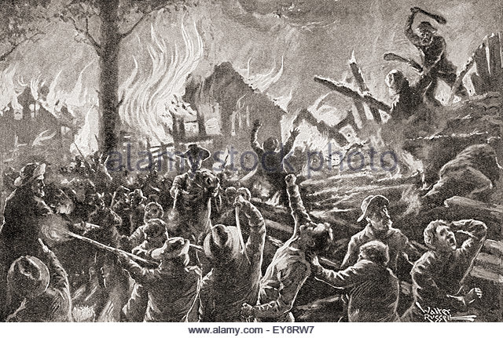
Kansas Nebraska Act
1854
Law created that allowed states to vote whether they would be slave or free.
Settlers from both sides rush into Kansas and begin to fight.
Violence leads to a time known as “Bleeding Kansas”.
Kansas eventually enters into the union as a free state. (1861)
Nebraska doesn’t become state until after the war.

Slide 12
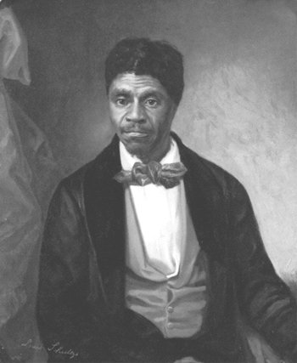
Dredd Scott Case (1857)
Dred Scott was a slave owned by an army surgeon in Illinois, Dr. John Emerson.
Emerson was also stationed in Louisiana and Florida and while he was in Florida, he left Scott in St. Louis, Missouri.
Emerson died and his wife, Irene Emerson refused to let Scott purchase his freedom.
Scott decided to sue for his freedom.
This case - Dred Scott v. Sandford will make it to the Supreme Court
The Supreme Court Chief Justice Roger Taney will rule:
No black person could ever be a citizen of the U.S. and thus blacks could not sue in federal courts
Congress does not have the power to prohibit slavery in the federal territories and thus the Missouri Compromise of 1820 was unconstitutional (as well as any restriction on slavery).

Slide 13
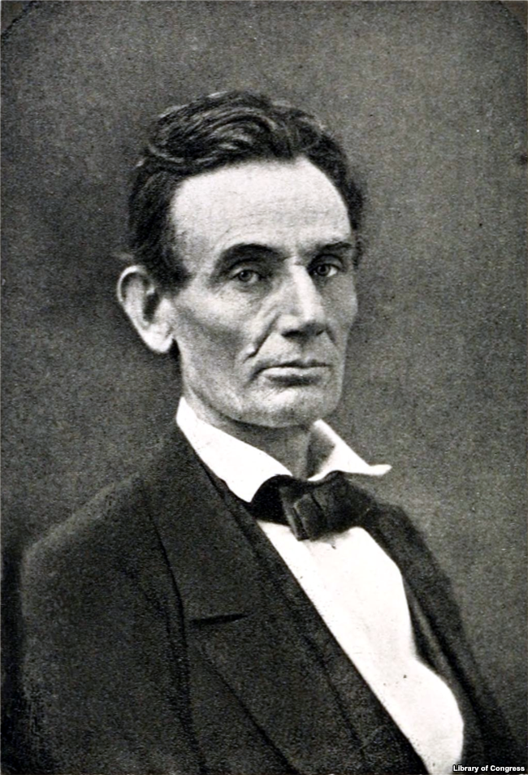
The Election of Lincoln and the start of Secession
The final situation that plunged the United States into the Civil War was Abraham Lincoln’s election in 1860.
Lincoln was the nominee of the Republican Party, a party that began in 1854 and whose primary goal was to prevent the expansion of slavery.
Lincoln did not run on a platform of ending slavery. Instead he wanted to halt it’s expansion.
Lincoln famously debated Stephen Douglass seven times in 1858 about his views on slavery.

Slide 14
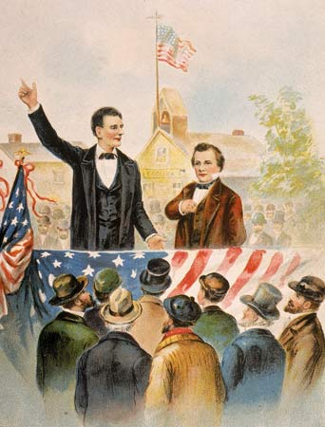
Lincoln Douglass Debates
Lincoln- Republican (anti slavery)
Stephen A Douglass- Democrat (pro slavery)
Debates were notable because Lincoln voiced his opinion about his views on slavery.
One of the reasons the South disliked him so much they succeed after his election.
Was a sight to see as Lincoln was 6ft 4in tall and Douglass was 5ft 4in tall.

Slide 15
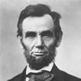
Northern Response to Southern Succession
March 1861 – Abraham Lincoln took office as President of the United States
North said that the Union was older than the states it had created them
Believed the Union had to be preserved
South believed that majority rule was a threat to their liberty
North believed south was pouting because they lost the election

Slide 16
The Failure to Compromise
Lincoln said that the national government would not abandon its property in the south.
This included military bases and other federal government lands.
Said that the Union wouldn't use force in the south unless the south acted first.
Eventually this will come to a head at Ft. Sumter in South Carolina.

Slide 17
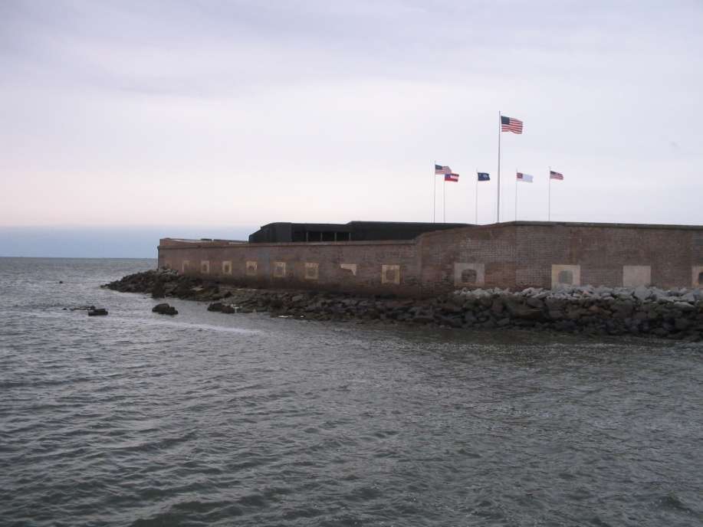
Crisis at Fort Sumter
Confederate soldiers take over government, military installations
Fort Sumter—Union outpost in Charleston harbor
Confederates demanded surrender of Fort Sumter
Fort Sumter and Fort Pickens needed supplies
- supply ships had been forced to turn back after being fired on by South Carolina gunners

Slide 18
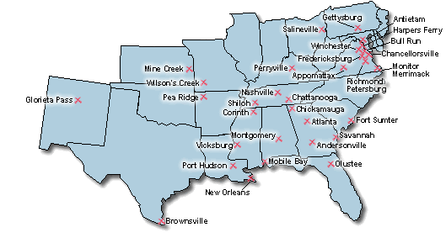
Crisis at Fort Sumter
Lincoln faced tough decision concerning the forts
- Withdrawing the troops would be recognizing the Confederacy
- Sending supplies meant risking war
- Reinforcing the fort with force would also lead rest of slave states to secede

Slide 19
Crisis at Fort Sumter
April 1861 - Lincoln announced that he was sending relief expeditions to the forts
Meant he would fight if necessary
For South, no action would damage sovereignty of Confederacy
Jefferson Davis chose to turn peaceful secession into war

Slide 20
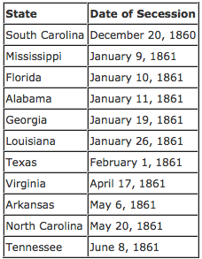
Other States Secede
After the fight at Ft. Sumter the other Sothern States secede from the Union.
Jefferson Davis is chosen as President of the confederacy and Alexander Stephens (from GA) becomes Vice President.
Georgia was the 5th state to succeed on January 19th, 1861

Slide 21
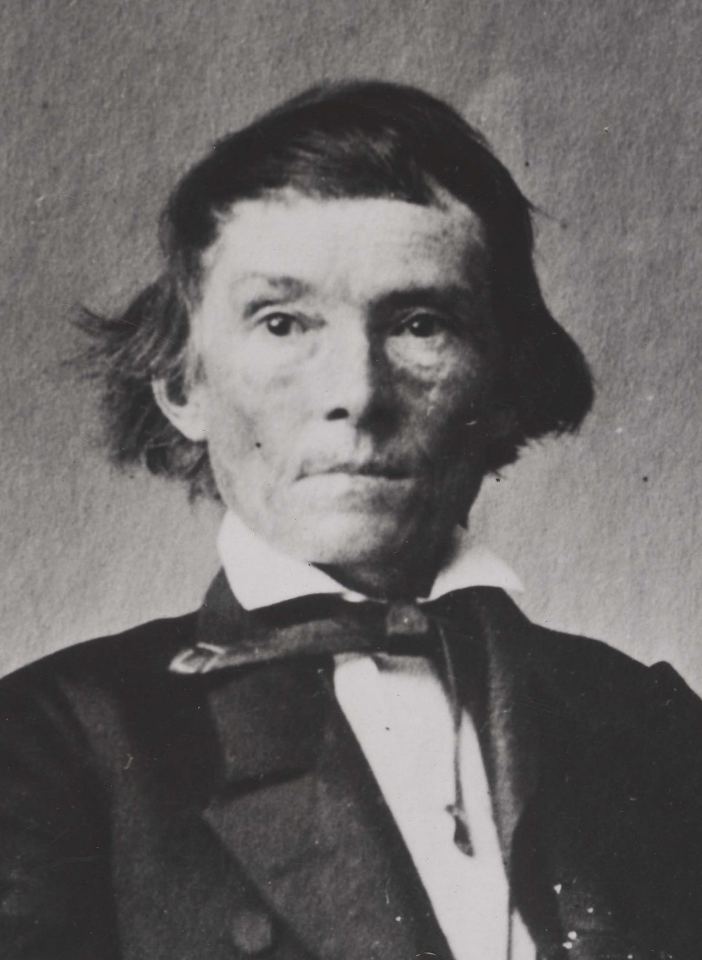
Debate over Secession in Georgia
In 1861, there was a spirited debate over secession in the Georgia General Assembly to determine if Georgia should secede from the Union.
During the debate, there were those who did not want to leave the Union, including representatives from the northern counties, small farmers and non-slave holders, and most importantly Alexander Stephens, who gave an eloquent speech against secession.
On the other side, were large farmers and slave holders who had a social and economic stake in the continuation of the institution of slavery.
General Assembly ultimately voted 208 to 89 in favor of secession.

Slide 22
Back to States Rights- The Nullification Crisis
A states’ rights issue, the nullification crisis in the early 1830’s, was a dispute over tariffs.
The North supported high tariffs to subsidize their fledgling manufacturing industry against the cheaper products that could be sent to the United States by Great Britain.
The South was opposed to this tariff because it took away profits from cotton farmers based on Great Britain’s retaliatory tariff on cotton.
When the Northern states, who dominated the House of Representatives, voted to renew the tariff, South Carolina threatened to nullify (cancel) the tariff and even possibly secede.
Andrew Jackson’s threat to attack South Carolina if they attempted to leave the union worked well enough to keep the state in the fold for the time being.

