Slide 1
Unit 2: Native Americans and European Exploration

Slide 2
Standards
SS8H1 Evaluate the impact of European exploration and settlement on American Indians in Georgia.
a. Describe the characteristics of American Indians living in Georgia at the time of European contact; to include culture, food, weapons/tools, and shelter.
b. Explain reasons for European exploration and settlement of North America, with emphasis on the interests of the Spanish and British in the Southeastern area.
c. Evaluate the impact of Spanish contact on American Indians, including the explorations of Hernando DeSoto and the establishment of Spanish missions along the barrier islands.

Slide 3
Standards (Continued)
SS8H2 Analyze the colonial period of Georgia’s history.
Explain the importance of the Charter of 1732, including the reasons for settlement (philanthropy, economics, and defense).
Analyze the relationship between James Oglethorpe, Tomochichi, and Mary Musgrove in establishing the city of Savannah at Yamacraw Bluff.
Evaluate the role of diverse groups (Jews, Salzburgers, Highland Scots, and Malcontents) in settling Georgia during the Trustee Period.
Explain the transition of Georgia into a royal colony with regard to land ownership, slavery, alcohol, and government.
e. Give examples of the kinds of goods and services produced and traded in colonial Georgia.

Slide 4
Glossary
Mercantilism
Missions
Hernando De Soto
Royal Colony
Trustee Period
Charter 1732
Debtor
Defense
Economics
Chert
Commoners
Elites
Horticulture
Maize
Mississippian Indians
Okefenokee
Wattle and Daub
Indigo
Mulberry Tree
Philanthropy
Royal Governor
Worthy Poor
W.R.I.S.T. crops
Yeoman farmer

Slide 5
Glossary (2)
De facto
Ebenezer/New Ebenezer
Highland Scots
Mary Musgrove
James Oglethorpe
Tomochichi
Darien
Buffer Colony
Malcontents
Salzburgers
Incentives
Bounty
Rice Rivers
Silk Industry

Slide 6
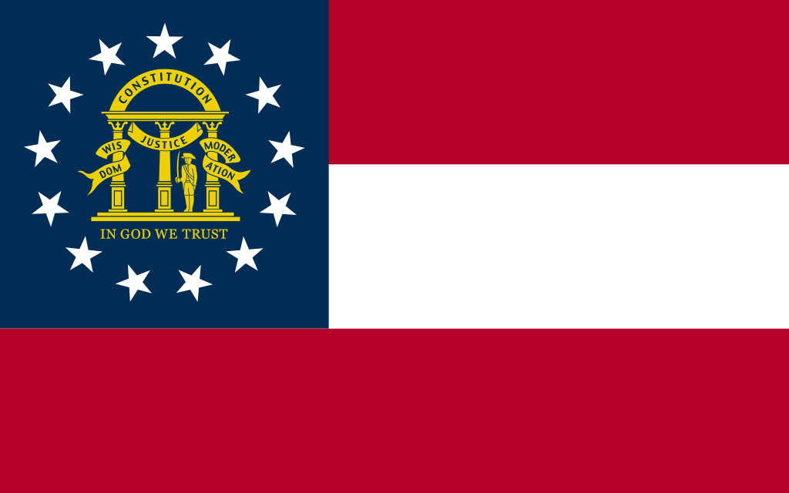
The Founding of Georgia
Georgia was “founded” on February 12, 1773.
Before Oglethorpe and the British arrived there were several groups of people who lived in Georgia for over 12,000 years.
Who were these people and where did they come from?

Slide 7
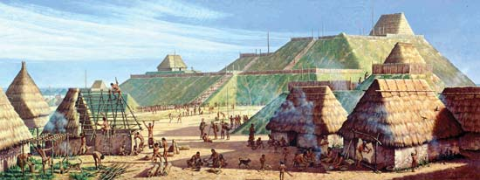
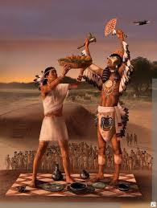
Early People of Georgia
The earliest groups of people in Georgia were the Paleo, Archaic and Woodland.
The Mississippian Indians were the group in Georgia at the time the Europeans (Spanish) arrived in North America in 1540’s.
The Mississippian’s rose to dominance in Georgia about 800 CE.

Slide 8
Native American Cultures
10000 BCE
8000 BCE
1000 BCE
800 CE
1600 CE
Archaic
Mississippian
Paleo
Woodland
© 2014 Brain Wrinkles

Slide 9
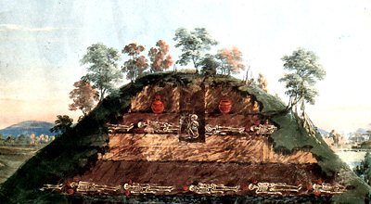
Mississippian American Indians
The Mississippian culture was a complex “chiefdom” society.
chiefdom- hierarchical society of “elites” (power holders) and “commoners” (work force)
The Mississippian created large towns near rivers that featured a central plaza, residential zones and defense structures (palisades, guard towers, and moats).
The focus of the plaza was the earthen mounds dedicated to religious and social activity. Some served as cemeteries.

Slide 10
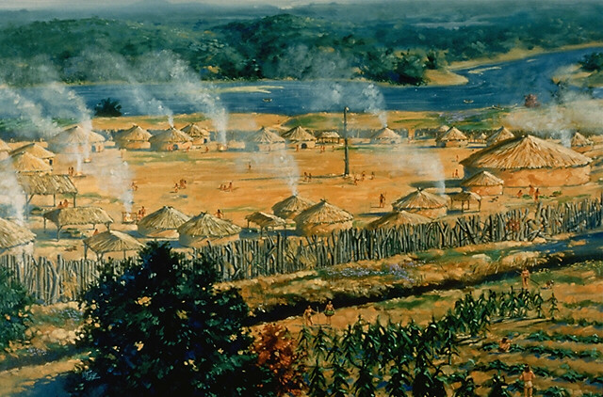
Mississippian Towns
The focus of the plaza was the earthen mounds, dedicated to religious and social activity. Some served as cemeteries.
Thousands of families lived in these towns. One-room wattle and daub shelters (walls built of a network of interwoven sticks and covered with mud or clay) served as sleeping facilities as they usually spent their days in the open.

Slide 12
Mississippian Society and Culture
The Mississippian Indians used stone, wood, and bone to create weapons and farming tools.
They were accomplished craftsmen, creating pottery, pipes, instruments, and jewelry.
A widespread trade network connected Mississippian towns.
Trade with other towns consisted of raw materials as well as finished goods, including shell beads, pottery with abstract images, and stone tools.

Slide 13
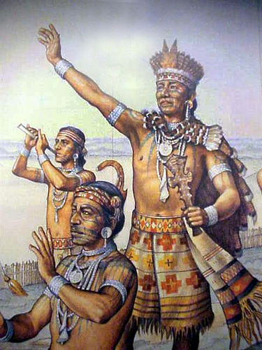
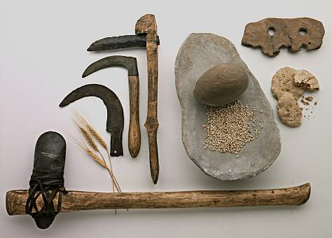
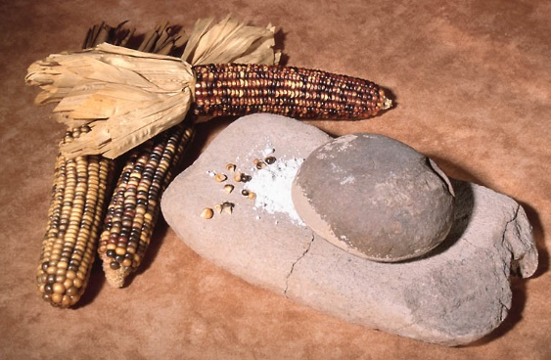

Slide 14
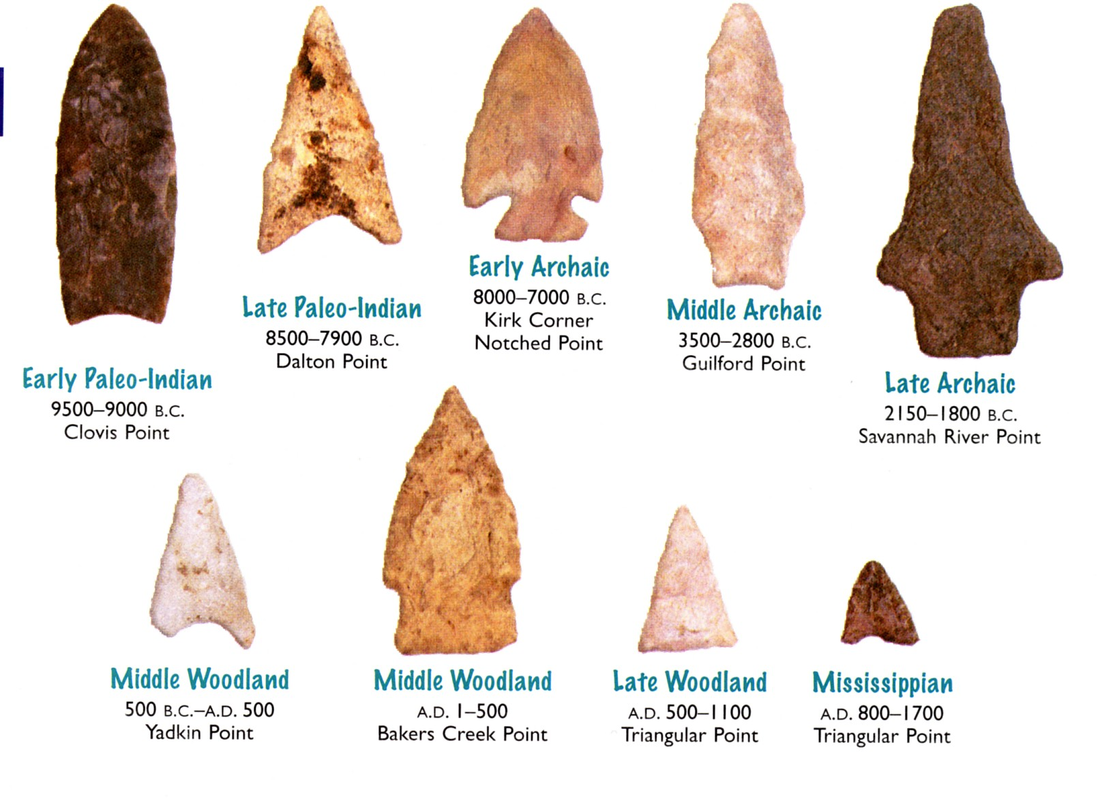

Slide 15
Agriculture and Hunting
Early Mississippians practiced horticulture (garden cultivation) and eventually moved into large scale agriculture as their population swelled.
Initially, maize (corn) was their dominant crop and they eventually added squash, sunflowers, pumpkins, and beans.
Unlike today’s farmers, the Mississippians did not plant fields of individual crops. Instead, the fields were intermixed with a variety of plants. Tall corn stalks provided a shield against damaging sun rays for ground level crops. Tobacco was planted for ritual usage.
Using bows and arrows and chert (sedimentary rock) knives, bone evidence indicates that they hunted deer, rabbit, muskrat, beaver, raccoon, and turkey. Turtle and fish were also a part of their diet. They gathered seasonal fruits, including plums, grapes, blackberries, and raspberries as well as a variety of nuts.

Slide 16
The Mississippian (conclusion)
They built flat-topped burial mounds and had religious ceremonies.
The dead were buried in fine cloths with feathered headdresses and the bodies were tattooed and painted.
They were alive when Europeans discovered America in the mid-1500’s, but soon after their culture began to disappear, as they succumbed to disease and the group eventually reorganized into the Creek and the Cherokee.

Slide 18
Part 2: European Exploration

Slide 19
Reasons for European Exploration
Natural Resources & Gold
Trade route to India
New Markets
Overcrowding in Europe
Freedom from Religious Persecution

Slide 20
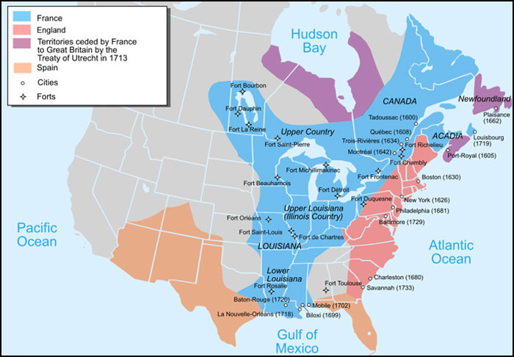

Slide 21
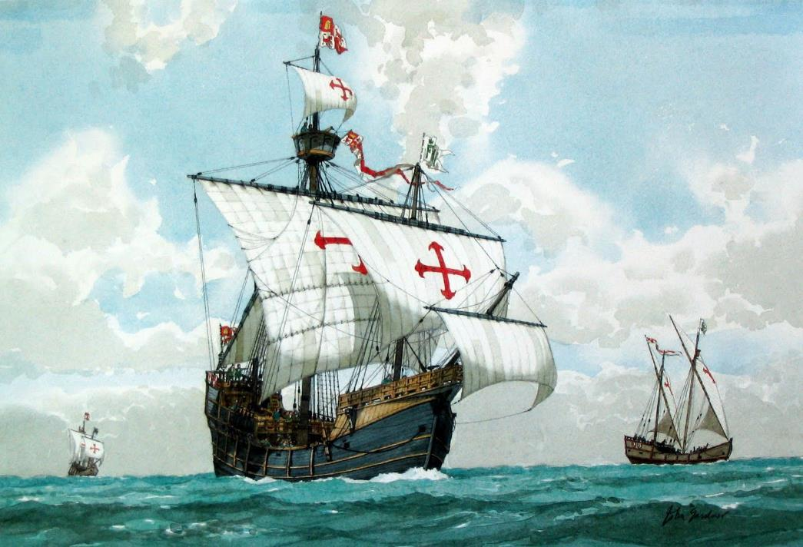
Key Figures in Discovery
Columbus discovers America in 1492.
Sailed for the Spanish (he was Italian)
Wanted a route to India. Sought gold, spices, silk.
Landed in Caribbean.
Made 4 voyages to Americas.

Slide 22
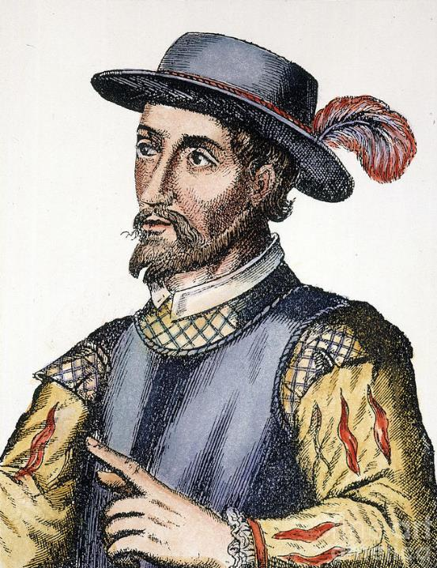
Spanish explorer & governor of Puerto Rico
Searched for a mythical “Fountain of Youth”
Claimed Florida for Spain in 1513

Slide 23
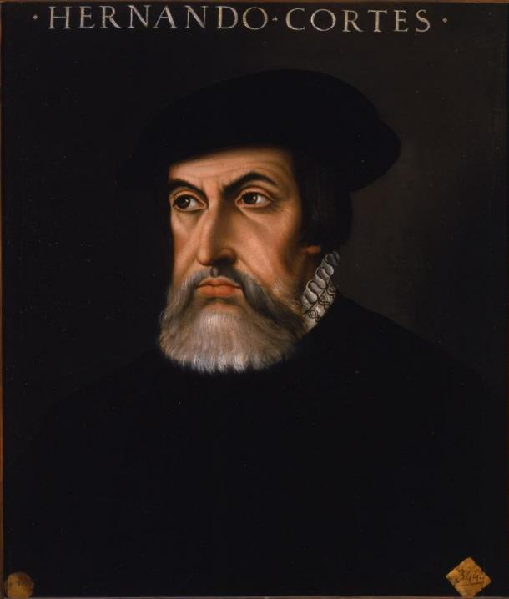
Spanish conquistador
Conquered the Aztecs in 1519-1521
Claimed Mexico for Spain

Slide 24
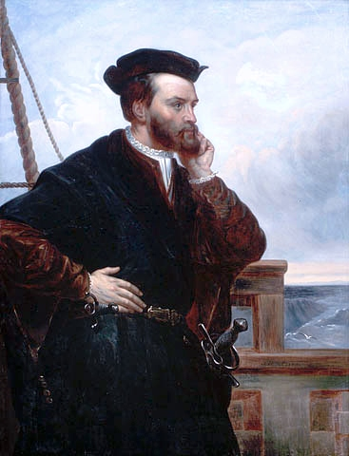
French explorer
Sailed up St. Lawrence River looking for a NW Passage
Named & claimed Canada for France
Made 3 voyages to explore Canada

Slide 25
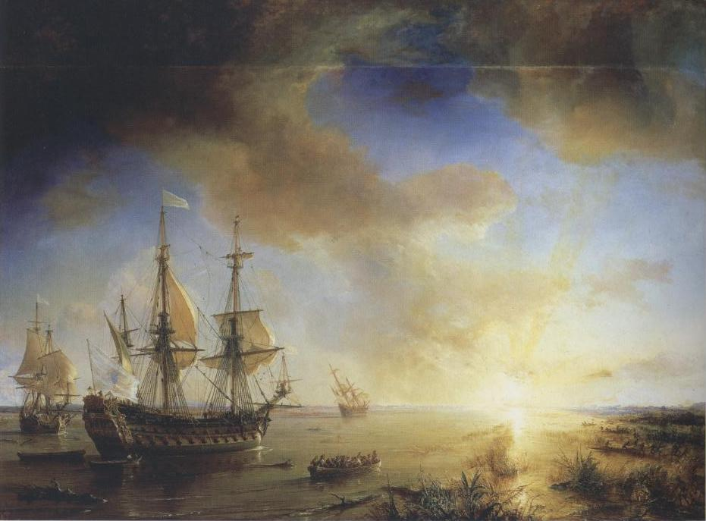
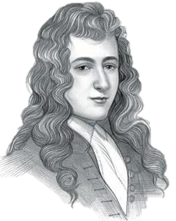
French explorer
Explored & established forts from the Great Lakes down the Mississippi River
Claimed Louisiana for France

Slide 26
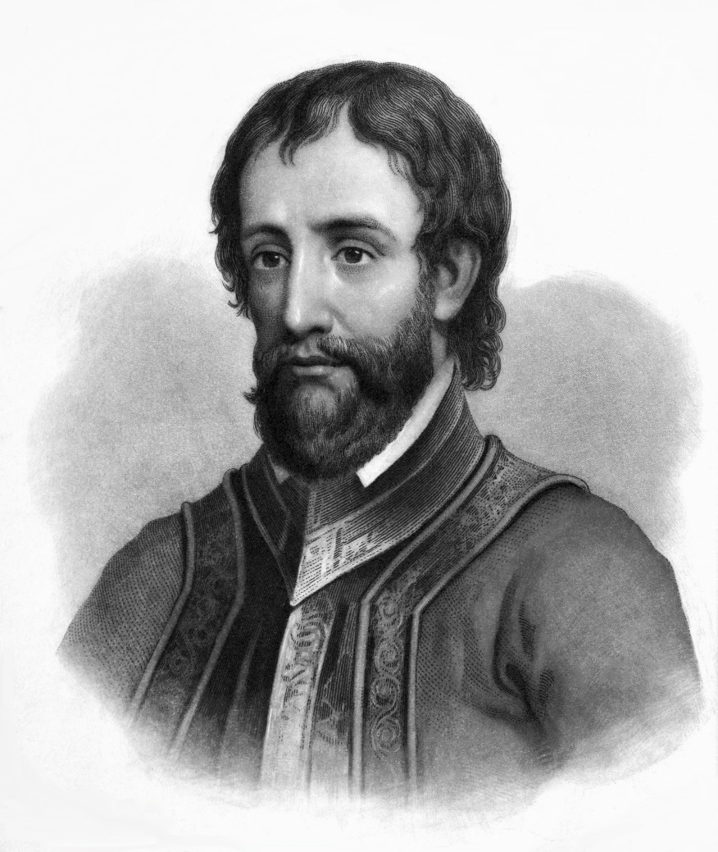
Hernando De Soto
Hernando DeSoto was the first known European explorer in Georgia.
Was directly responsible for starving and killing a large number of American Indians in his quest for God, gold and glory.
Without an established plan for exploration, DeSoto and his men moved from Florida into southwest Georgia in their search for gold.
The American Indians often provided DeSoto false information regarding vast stores of gold further north in an attempt to protect their own villages/towns. Though DeSoto never found the gold he desired, he did introduce Europe to southeastern North America

Slide 27
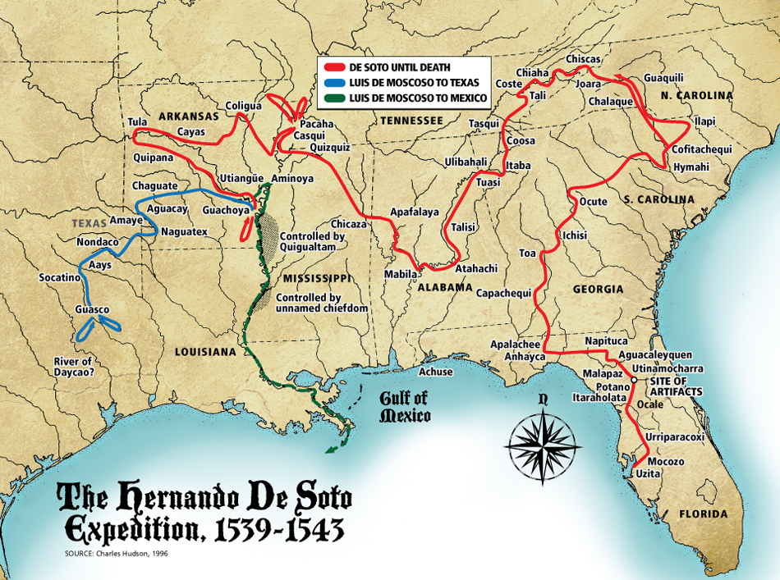

Slide 28
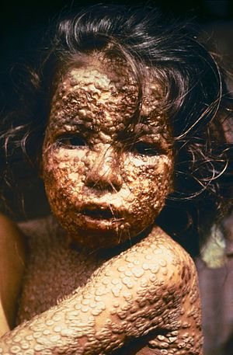
De Soto (continued)
The journals maintained by DeSoto’s men are the first to give insight into the Mississippian chiefdom culture.
DeSoto’s journey is credited with introducing pigs to North America and devastating diseases to the American Indian culture.
Smallpox was spread by the extensive trade network utilized by the Mississippians. Measles and influenza also attacked the Mississippians at alarming rates.

Slide 29
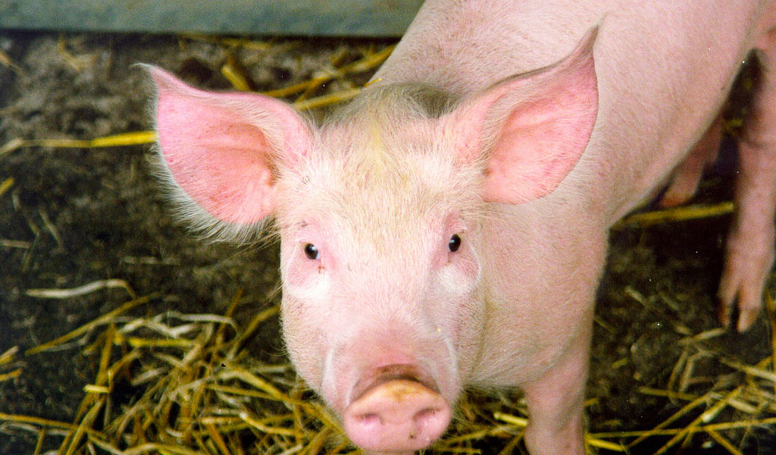
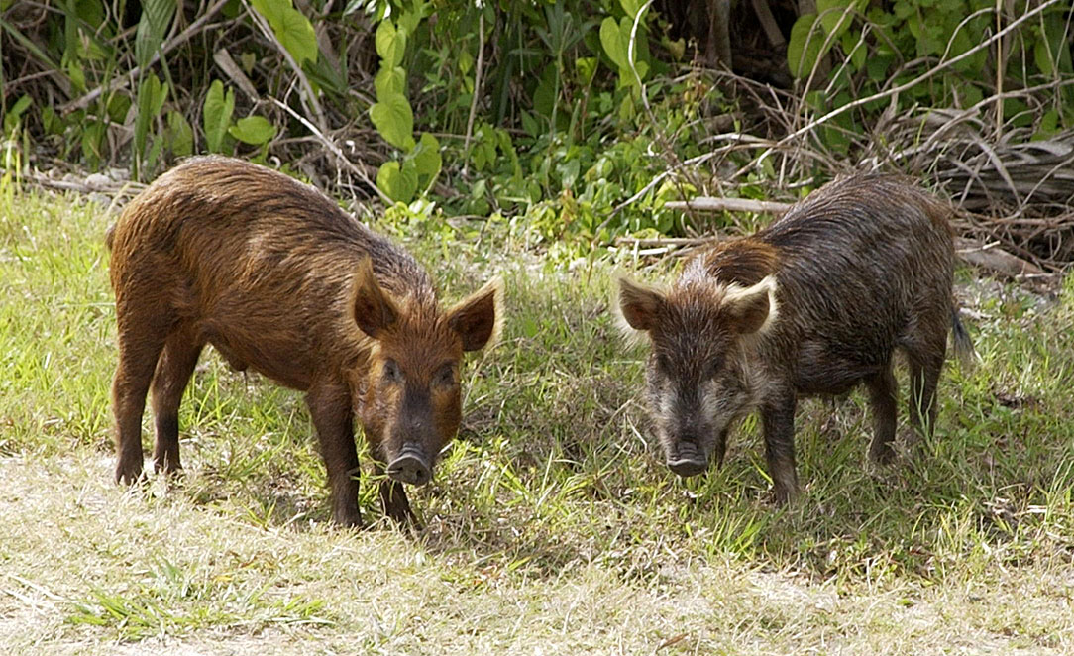
Pigs

Slide 30
De Soto (continued)
DeSoto’s failed expedition (his men never found gold and he died near the Mississippi River and was buried in the river) led to increased efforts by the French and Spanish to explore the southeast coastline and to establish colonies.
Colonization efforts were not met with great success. However, the most successful Spanish colonization attempt was during the “Mission Period” from 1568 – 1684. It was during this period that Spain built several missions (churches) on the barrier islands as well as on the mainland.
These sites included missions on Cumberland Island, St. Catherine’s Island, and near the Okefenokee Swamp. Missions built on the mainland were located as far inland as the current cities of Valdosta and Lumber City.

Slide 31
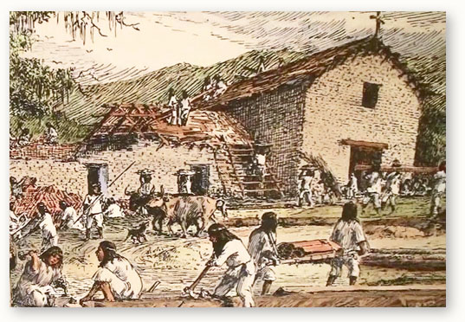
Spanish Mission

Slide 32
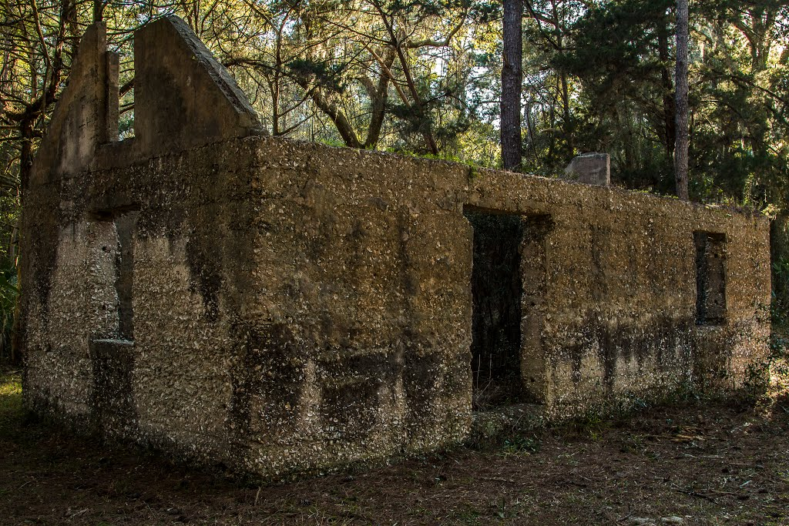
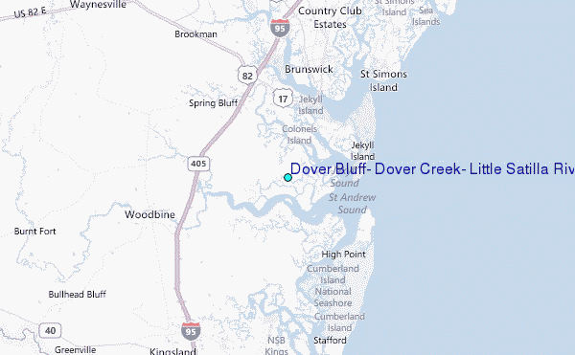

Slide 33
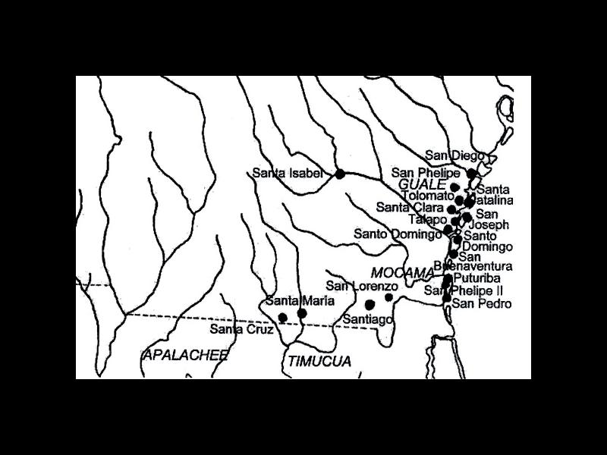

Slide 34
Mission Period
Spanish missions were located near Mississippian towns so the priests and friars could achieve their primary goal: the conversion of the American Indians to Christianity (Catholicism).
Consequently, the missions encouraged the American Indians to embrace Spanish political and economic systems.
As an example, to show allegiance to the Spanish, unmarried American Indian males were required to work in Saint Augustine for several months out of the year, causing considerable change to the American Indian society.

Slide 35
Mission Period (continued)
The close contact with the Spanish brought disease and death to the American Indians, who were increasingly disturbed by the changes to their own culture.
By the mid-1600’s, the Spanish mission system was crumbling.
British influence (based in the South Carolina colony) often stirred American Indians to raid the missions and, by 1680’s, coastal missions were abandoned by the Spanish. A pirate raid in 1684 pushed the remainder of the mission American Indians into Florida, ending the Spanish mission period in Georgia.

