Slide 1
8th Grade Georgia History Warm Ups

Slide 2
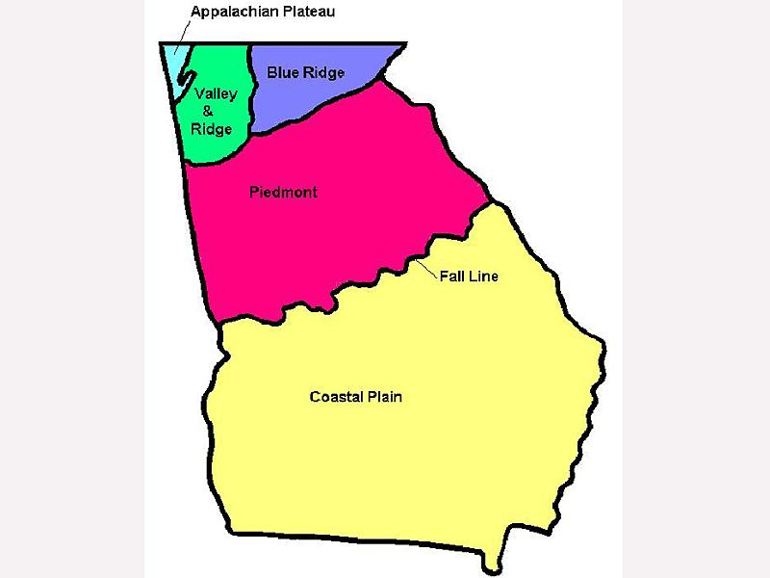
#1: 8/2/2017
1. Which region do you live in?
2. How would you describe this region’s economy?
3. How would describe its climate?

Slide 3
#2: 8/3/2017
If you were going to start a business in the Appalachian Plateau what would it be? Why?
What resources does this region have that would help you create this business?
What do you think would be the biggest hurdle in making your businesses a success?
Do you think it would be more successful in a different region?

Slide 4
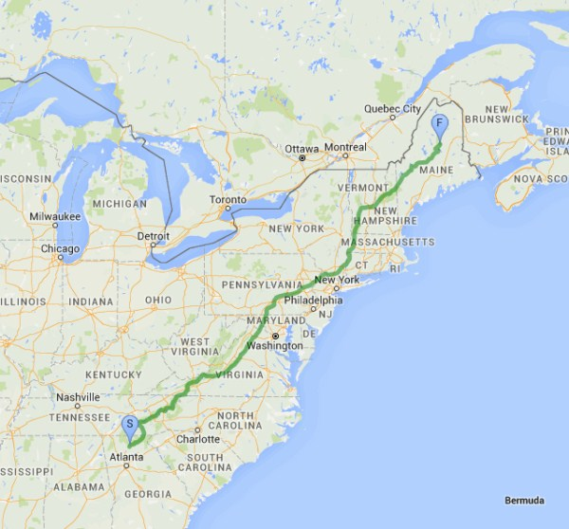
#3: 8/4/2017
Which region would you find the Appalachian Trail?
Can you name 3 other states the trail passes through besides Georgia?
If you were going to hike the trail and could only bring 10 items, what would you bring?

