Slide 1
U.S. History Chapter 11 Notes The Civil War
In the bloody Civil War, Union forces devastate the South and defeat the Confederacy. President Lincoln narrowly wins reelection, but is assassinated as the war ends.

Slide 2
Part 1 The Civil War Begins .
The secession of Southern states cause the North and the South to take up arms

Slide 3
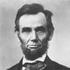
Northern Response to Southern Succession
March 1861 – Abraham Lincoln took office as President of the United States
North said that the Union was older than the states it had created them
Believed the Union had to be preserved
South believed that majority rule was a threat to their liberty
North believed south was pouting because they lost the election

Slide 4
REVIEW: Ft. Sumter: 1st Battle
Remember that Ft. Sumter was started after the North refused to give up their military bases in south.
Jefferson Davis ordered attack when Lincoln tried to restock fort.
7 states had already seceded, final 4 secede after Ft. Sumter. (Virginia, Arkansas, North Carolina, Tennessee)

Slide 5
The Sides Take Shape
Confederacy
Union
Union
Ohio
Oregon
Pennsylvania
Rhode Island
Vermont
Wisconsin
South Carolina
Mississippi
Florida
Alabama
Georgia
Louisiana
Texas
Virginia
Arkansas
Tennessee
North Carolina
California
Connecticut
Illinois
Indiana
Iowa
Kansas
Maine
Massachusetts
Michigan
Minnesota
Missouri
Nevada
New Hampshire
New Jersey
New York
Border States
Delaware
Maryland
Kentucky
Missouri
West Virginia

Slide 6
Choosing Sides
Border states were the key to the war
North had to have Maryland to keep contact with Washington D.C.
- Lincoln ordered the arrest of lawmakers who had supported the south
- Federal troops helped a group of western counties break away from Virginia (West Virginia)
War caused many families in the border states to spilt

Slide 7
Expecting a Short War
That war came as no surprise
Both sides had been arguing for years
Everyone thought the war would be short
Everyone was excited
April 1861 – May 1865
620,000 deaths(estimate)

Slide 8
Both Sides Strengths
North
- Had more people
- Had most of the natural resources (iron, coal, copper)
- 86% of the nation’s factories in the north
- Union kept almost every ship in the navy
- More extensive railroad system
- Lincoln’s leadership
South
- Had better generals
- cotton profits
- Fighting a defensive war (more of a will to fight)

Slide 9
Strategy
North
- Aimed to conquer south and bring it back into the Union
- Didn’t have a strong enough army to invade the south a the beginning
- Anaconda plan: Union strategy to conquer South
- blockade Southern ports
- divide Confederacy in two in west
- capture Richmond, Confederate capital
South
- Only wanted to stay independent
- Wanted to avoid major battles (hoped the north would get tired of fighting)
- Invade North if opportunity arose
- Beginning of the war south withheld cotton from Europe (hoped Europe would help south due to their need for cotton (BIG MISTAKE)
- Europe found other places to get cotton

Slide 10
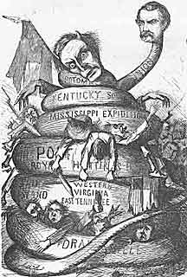
Northern Strategy: Anaconda Plan
Form a blockade around all southern ports
Take control of Confederate Capital
Take control of Mississippi River—cut Confederacy in half
Invade the heart of the South and crush

Slide 11
The Two Armies
1861 – Union was unprepared to fight
- Many soldiers were city residents
Southern army had organized before the battle of Fort Sumter
Southerners were used to shooting guns
Neither army had uniforms (created confusion)
- Union wore blue
- Confederates wore grey

Slide 12
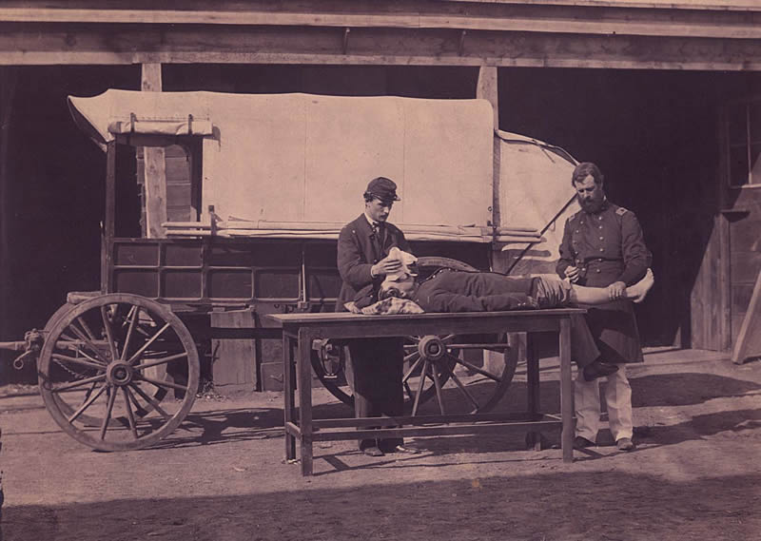
Miserable War
Didn’t have antiseptics – germ killing drugs
Didn’t have anesthetics – pain killing drugs
- Soldiers had to bite bullets when being operated on

Slide 13
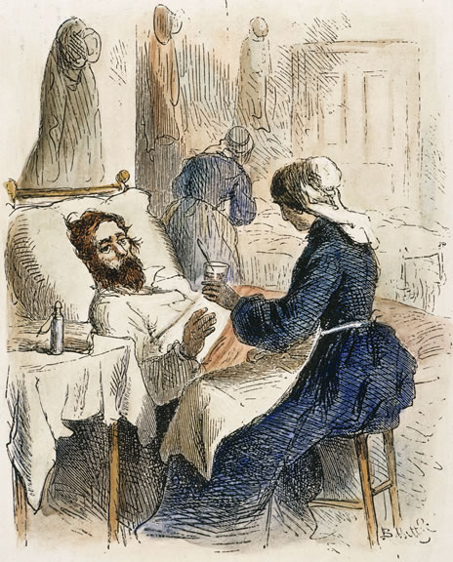
Soldiers Suffer on Both Sides
Lack of sanitation, personal hygiene lead to disease in camp (Body lice & diarrhea)
Diets were unvaried, limited, unappealing
North ate beans, bacon and hard square biscuits
South ate a stew of small cubes of beef, crumbled cornbread mixed with bacon grease
South had to use substitutes for coffee (peanuts, dried apples, & corn)

Slide 14
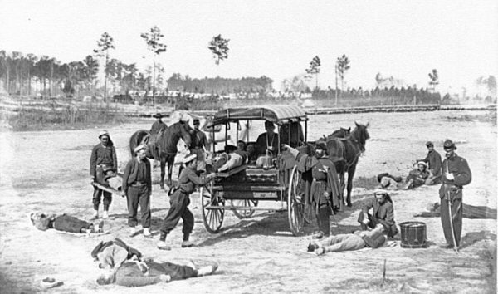
Civil War Medicine
U.S. Sanitary Commission worked to improve hygiene in army camps
It hired & trained nurses
Dorothea Dix served superintendent of women nurses
Only hired women over 30 years old to avoid romance
- Union death rate drops
Surgeon general ordered at least 1/3 of Union nurses be women
Union nurse Clara Barton served on front lines
Southern women also volunteered as Confederate nurses

Slide 15
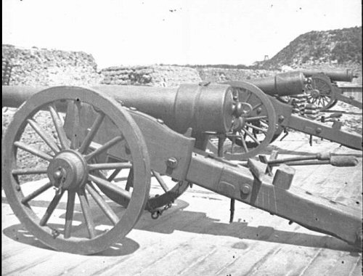
A Revolution in Warfare
New Weapons
- Rifles more accurate, faster loading, fire more rounds than muskets
- Minié ball (more destructive bullet), grenades, land mines were used
- Fighting from trenches, barricades new advantage in infantry attacks

Slide 16
Key People of the Civil War
Northern Generals: Ulysses S. Grant, William T. Sherman
Southern Generals: Robert E. Lee, Stonewall Jackson
Union President: Abraham Lincoln
Confederate President: Jefferson Davis

Slide 17
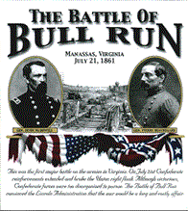
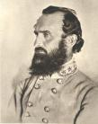
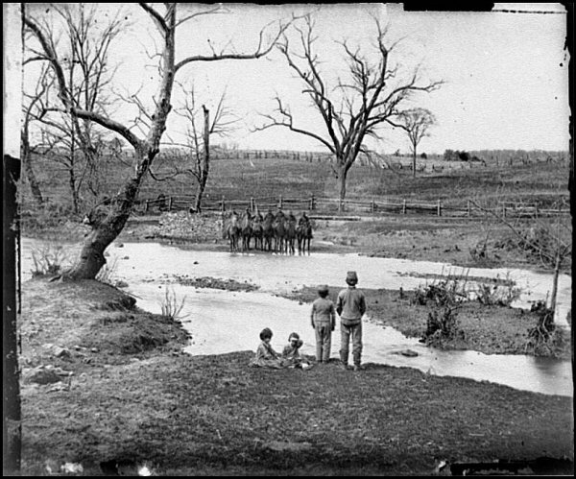
First Battle of Bull Run July 21, 1861
Union army was marching to Manassas
Sightseers and picnickers followed to watch the battle
Thomas J. Jackson earned nickname “Stonewall” for firm stand in battle
Confederates forced the Union to retreat
- Union army got tangled up with the sightseers

Slide 18
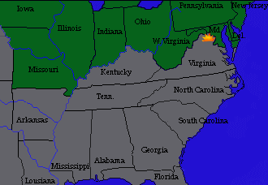
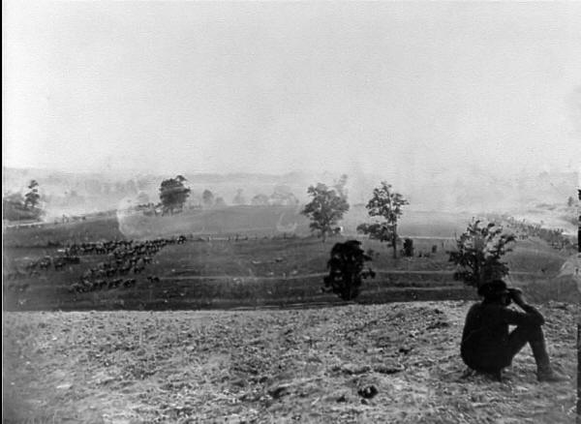
Battle of Antietam September 22, 1862
Union army found a copy of Lee’s battle plans
Bloodiest single-day battle of the war
- 23,000 men died (more than the war of 1812 & war with Mexico combined)
Ended in a draw
- Confederates retreat
- McClellan does not pursue
- Lincoln fired McClellan
Considered a political victory for the north
- Caused Europe to delay plans to help the south

Slide 19
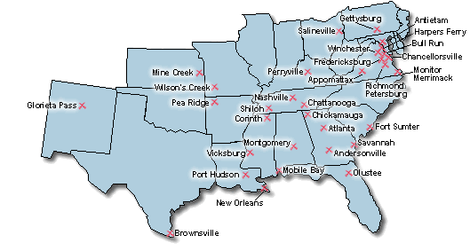

Slide 20
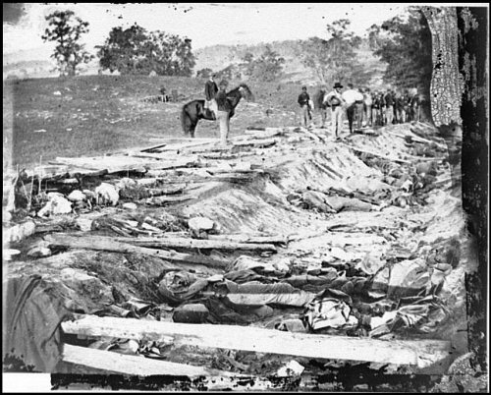

Slide 21
Section 3 The Politics of War
By issuing the Emancipation Proclamation, President Lincoln makes slavery the focus of the war

Slide 22
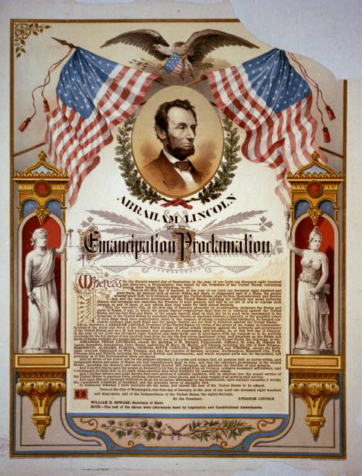
Emancipation Proclamation
January 1, 1863 Lincoln issued the Emancipation Proclamation
- President Lincoln’s announcement that he would free the slaves in the rebelling states (military strategy)
Proclamation had symbolic value by giving the war a high moral purpose (Ending Slavery)

Slide 23
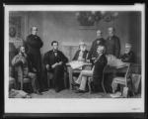
Emancipation Proclamation
Northern Democrats claimed it would antagonize South & prolong war
Changed the character of the war (The Old South was to be destroyed)
- Confederacy became more determined to preserve way of life
- Compromise was no longer possible

Slide 24
Emancipation Proclamation
Didn’t free the slaves in the loyal border states
- Didn’t have the power under the constitution
Also declared that African Americans could enter the army
- Free blacks welcome ability to fight against slavery
- 54th regiment gained fame attacking Fort Wagner in South Carolina

Slide 26
Both Sides Face Political Problems
Neither side was completely unified
Both sides had sympathizers
Lincoln suspended habeas corpus:
- order to bring accused to court & name charges
Seized telegraph offices to prevent them from being used for subversion

Slide 27
Both Sides Face Political Problems
Copperheads - Northern Democrats advocating peace were among those arrested
Lincoln ignored Supreme court ruling that stated he had overstepped his constitutional boundaries
Davis denounced Lincoln, then suspended habeas corpus in South
Lincoln expands presidential powers & sets precedent (War time)

Slide 28
Conscription
Both sides relied on volunteers in the beginning
Casualties & desertions led to conscription - draft to serve in army
Both armies allowed draftees to hire substitutes to serve for them
Planters with more than 20 slaves were exempted “Rich mans war poor mans fight”
90% eligible Southerners served
92% of the Northern soldiers were volunteers

Slide 29
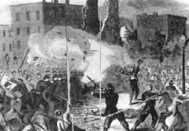
Draft Riots
Poor white workers thought it was unfair they should have to fight a war to free slaves
- Lived in disease ridden slums
White workers feared Southern blacks would move North & compete for jobs
1863 - Mobs rampaged through New York City after they began being drafted

Slide 30
Section 3
The Civil War brings about dramatic social and economic changes in American society.

Slide 31
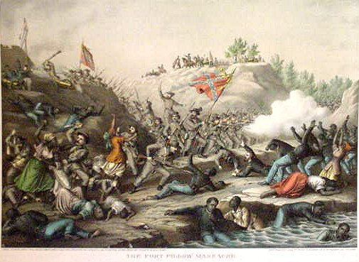
African Americans Fight for Freedom
African-American Soldiers
African Americans 1% of North’s population
Made up 10% of army by the end of the war
Received lower pay than white troops for most of war& limited on military rank
Suffered high mortality from disease
POWs were killed or returned to slavery
Fort Pillow, TN - Confederates massacred over 200 African-American POWs

Slide 32
Southern Shortages
South experienced food shortages from lost manpower, Union occupation& loss of slaves
Caused inflation
1861 - $6.65 for food per month
1865 $68 for food per month if available
Blockade created other shortages (salt, sugar, coffee, nails needles, & medicine)
Some Confederates traded with enemy
Smuggled cotton into the north in exchange for food, gold or other goods

Slide 33
Northern Economic Growth
Industries that supplied army boomed
Contractors made huge profits
Many workers’ standard of living dropped
Wages do not keep up with prices
Women replaced men on farms, city jobs & government jobs
Congress established first income tax on earnings to pay for war

Slide 34
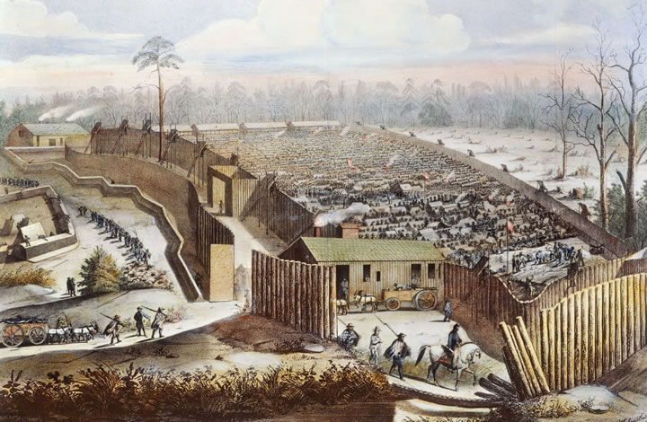
Prisons
Living conditions in prisons worse than in army camps
Andersonville - worst Confederate prison, in Georgia
Had no shelter or sanitation (men drank from same stream that served as sewer)
Housed 33,000 prisoners on 26 acres (34 sq. ft. per man)
1/3 of prisoners died
Camp commander Henry Witz was executed for war crimes after war

Slide 35
Prisons
Northern prisons were only a little better
Had more space , food & shelter than Southern
Prisoners were housed with little or no heat (died of pneumonia)
12% of Confederate prisoners & 15% of Union prisoners died

Slide 36
Section 4 The North Takes Charge
Key victories at Vicksburg and Gettysburg help the Union wear down the Confederacy

Slide 37
Road to Gettysburg
Both sides were tired of the war
Blockade was killing the south’s economy ($1 to $7 )
Northerners angry over the draft
May 1863 - South defeated North at Chancellorsville
- Stonewall Jackson mistakenly shot by own troops
- Died 8 days later of pneumonia
Lee led his army north to get supplies
Also hoped for a peace settlement

Slide 38
Battle of Gettysburg
Neither General intended to fight
- Troops ran into each other (Confederates go to find shoes; meet Union cavalry)
July 1, 1863 - Confederates drove Union back,& took town
The Second Day
- South attacked Union army
- Union army was Led by General George Meade on Cemetery Ridge
- North repulsed repeated attacks on Little Round Top
- Many exhausted Confederates surrendered & Union line held

Slide 39
Battle of Gettysburg
The Third Day
- Armies exchange vicious artillery fire
- Lee orders attack on Union lines (Pickett’s Charge)
- North cut down Confederates
- Meade didn’t counterattack
-Lee retreated to Virginia
Both sides suffered staggering losses
Considered the single greatest battle of the war
Three-day battle at Gettysburg crippled the South
Battle of Gettysburg is considered the turning point of war
General Lee wouldn’t never again have sufficient forces to invade the North

Slide 40
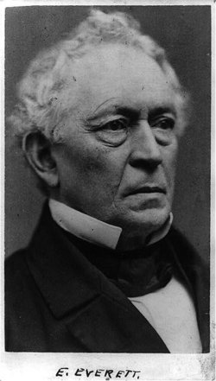
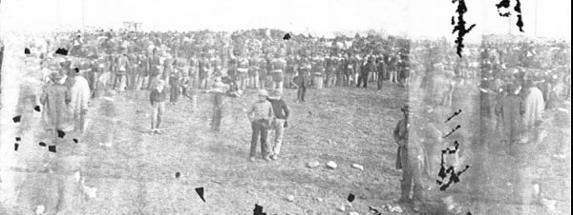
The Gettysburg Address
November 1863 - ceremony held to dedicate cemetery in Gettysburg
Edward Everett, noted speaker, gave flowery two-hour speech
Lincoln’s two-minute Gettysburg Address asserted unity of U.S.
- honored dead soldiers
- called for living to dedicate themselves to preserve Union & freedom

Slide 41
The Confederacy Wears Down
Defeats at Gettysburg & Vicksburg cost the south much of its limited fighting power
South was no longer able to unable attack
Only hoped to hang on and destroy North’s morale to get armistice
Civilian morale plummeted & public called for peace
Discord in government prevented Davis from governing effectively

Slide 42
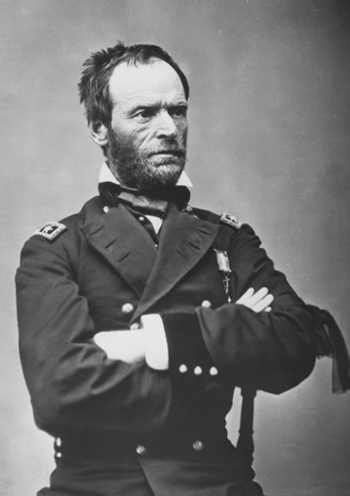
Grant Appoints Sherman
Lincoln wanted someone who would attack General Lee
March 1864 - Lincoln appointed Ulysses S. Grant commander of all Union armies
Lincoln liked Grant because he could get things done
Grant appointed William Tecumseh Sherman commander of the military division of the Mississippi

Slide 43
Grant Appoints Sherman
Grant planned to attack the south on all fronts
- He would pursue Lee
- Admiral Farragut would attack Mobile
- William Tecumseh Sherman would lead an army southeast from Chattanooga to Atlanta
Grant & Sherman believed in total war to destroy South’s will to fight

Slide 44
Sherman’s March
September 1864 - Sherman took Atlanta
South tried to cut supply lines (railroads)
Sherman changed strategies (Abandoned supply lines & burned Atlanta)

Slide 45
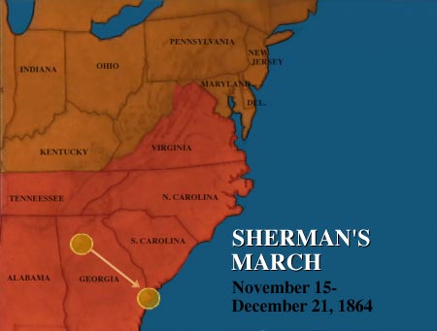
Sherman’s March
Sherman cut a wide path of destruction in Georgia & lived off the land
1st general to wage total war
- Destroyed everything in his path
Made no apologies for his actions
- Said “We are not only fighting hostile armies, but a hostile people, and must make old and young, rich and poor, feel the hard hand of war”

Slide 46
Sherman’s March
December 1864 – Sherman reached Savannah
Turned north to help Grant fight Lee
Inflicted even more destruction in South Carolina (1st state to secede)
Followed by 25, 000 former slaves who were eager for freedom
Burned almost every house in his path
Stopped destroying private homes when he reached North Carolina (last state to secede)
Began handing out food & supplies (realized the war was almost over)

Slide 47
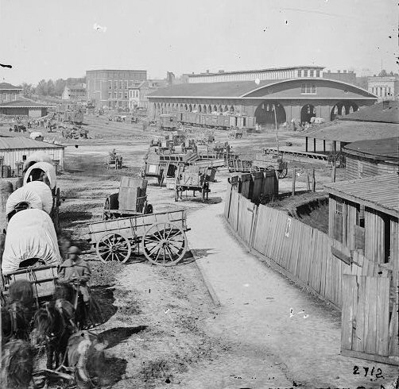
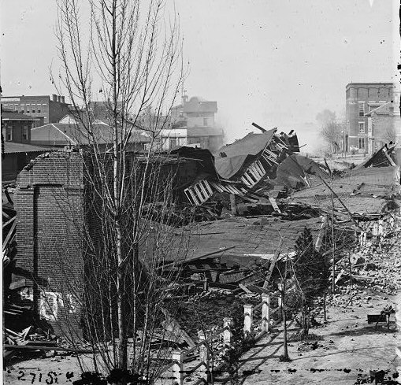
Atlanta Before & After

Slide 48
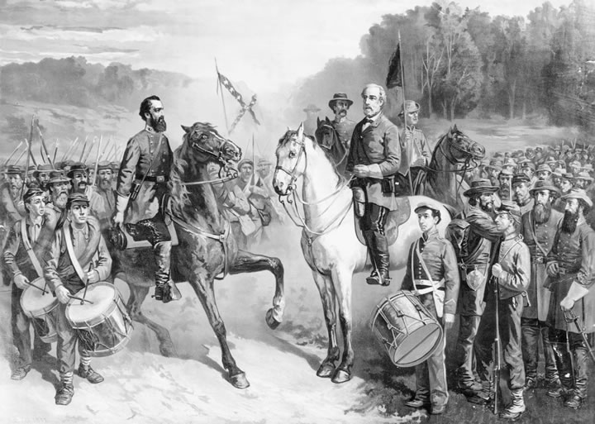
The Surrender at Appomatox
March 1865 – Clear that the south was going to lose
Union forces were closing in on Richmond
Grants forces defeated Lee’s at Petersburg
April 2 1865 - Davis’s government left Richmond, set it afire

Slide 49
The Surrender at Appomatox
April 9, 1865 – Lee and Grant work out the terms of surrender at Appomattox Court House
Lee’s soldiers paroled on generous terms (Lincoln’s request)
- Were given them food
- allowed to return to their homes and keep their horses

Slide 50
Section 5 The Legacy of the War
The Civil War settles long-standing disputes over states’ rights and slavery.

Slide 51
Political Changes caused by the War
Thirteenth Amendment (1865): Abolished Slavery
Fourteenth Amendment (1868): States cannot deny Civil Rights to any citizen. Basically says the Bill of Rights applies to the states.
Fifteenth Amendment (1870): The right to vote cannot be denied because of “ Race Color or Previous Condition of Servitude ”.

Slide 52
Costs of the War
Hundreds of thousands dead, wounded; lives disrupted
- 620,000 men died in the war
Financially, war costs the government estimated $3.3 billion

Slide 53
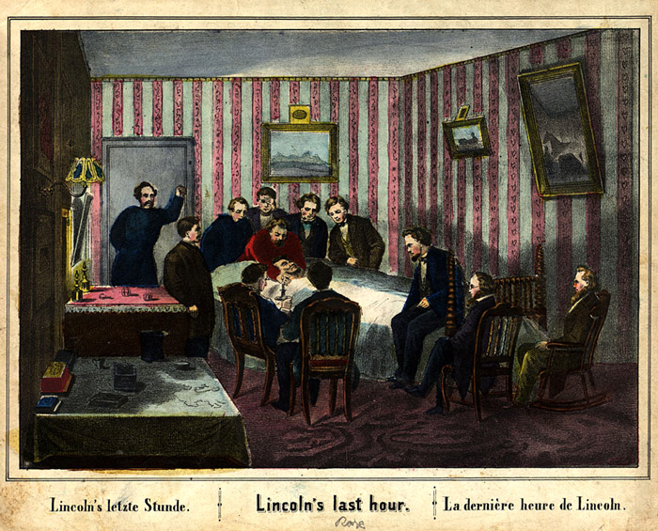
The Assassination of Lincoln
April 14, 1865 - Shot by John Wilkes Booth at Ford’s Theatre
1st president to be assassinated
Assassin John Wilkes Booth escaped but was trapped by Union cavalry 12 days later & shot in Virginia
7 million people paid respects to Lincoln’s funeral train (almost 1/3 of population

